Slide 1
Corinth Rift Seismicity and Applications
Dr. George Kaviris
Assistant professor of seismology – seismic anisotropy
section of geophysics and geothermics
department of geology and Geoenvironment
national and Kapodistrian university of athens
CRL School 2018, 21-25 September 2018

Slide 2
Introduction – Focal Mechanisms
Focal Mechanisms (or fault-plane solutions): they showcase the geometry and kinematics of the activated fault. They are determined with various methods. They are described by the strike φ (azimuth of the fault-plane, clockwise from the north), the dip δ (the angle between the fault-plane and the vertical plane) and the rake λ (corresponds to the movement direction of the hanging wall).
Focal Mechanisms are graphically represented by beachballs.
φ/δ/λ

Slide 3
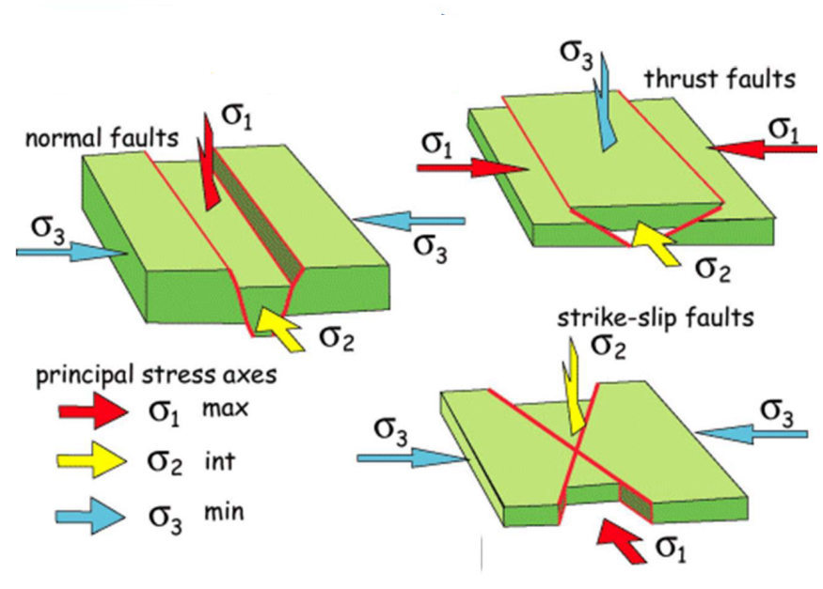
Introduction – Focal Mechanisms
Hanging wall: the block located over the fault plane.
Footwall: the block located beneath the fault plane.
There are 3 fundamental types of faults:
Dip – slip: the dominant movement in the focus is vertical (λ ≈ ±90°)
Strike – slip: the dominant movement in the focus is horizontal (λ ≈ 0° or ± 180°)
Oblique – slip: the dominant movement in the focus has a vertical and a horizontal component (other values of λ)
Dip and oblique – slip faults can be further categorized in:
Normal (λ > 0): the hanging wall moves downward and local lengthening (i.e. increase of space) exists. These faults are observed in regions with extensional forces, such as the Gulf of Corinth.
Reverse (λ < 0): the hanging wall moves upward and local shortening is observed. Reverse faults with small dip values (δ < 45°) are called thrust faults.
Faults can be further categorized in:
Dextral: right-lateral movement of the blocks (|λ| > 90°)
Sinistral: left-lateral movement of the blocks (|λ| < 90°)
Kassaras & Kaviris, 2017

Slide 4
Introduction – Focal Mechanisms
We can obtain the focal mechanism of an earthquake by analyzing the direction of the very first arrival of the P-waves. This method is called first P-wave motion polarities.
It requires a dense local network and can be applied in events of small magnitude, as long as clear and impulsive arrivals of direct P-waves exist.
It fails to provide reliable results if the network used is not close to the epicenter (poor P-wave arrival determination and the first motion is usually contaminated).
Does not provide constraints on which of the nodal planes corresponds to the fault (although, there are some additions to the method that improve on that, e.g. the use of polarization of S-waves).
It is a simple method that does not require the use of sophisticated software, or even a computer!

Slide 5
Introduction – Focal Mechanisms
Kassaras & Kaviris, 2017

Slide 6
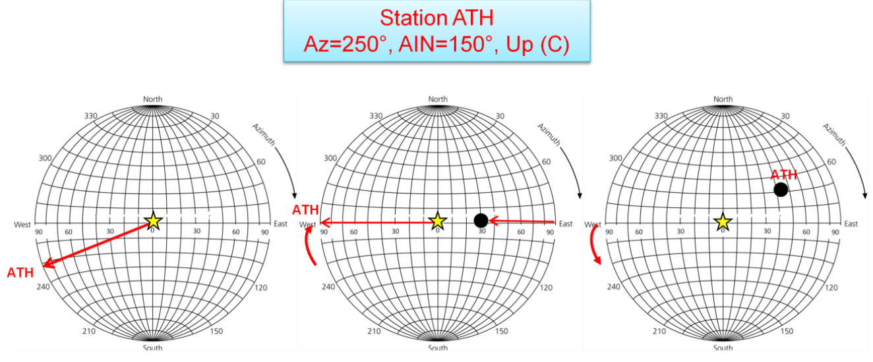
Introduction – Focal Mechanisms
The first motion of the P-wave arrival is first determined in seismograms (up – compression or down – dilatancy).
These are then projected to a Schmidt net (i.e. the equal – area projection of the lower hemisphere), a simple graphical way to determine a focal mechanism.
Initially, every first motion is noted on the Schmidt net, according to the azimuth and takeoff angle for that station.
Kassaras & Kaviris, 2017
Lines->planes
Dots->axes

Slide 7
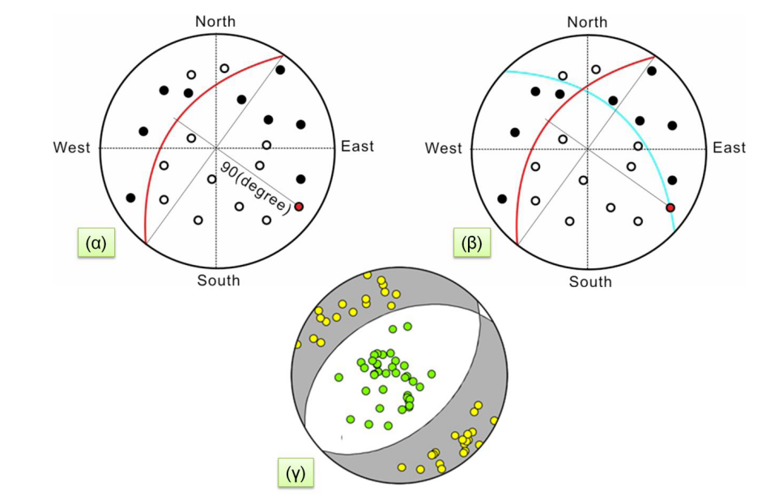
Introduction – Focal Mechanisms
Then, the first nodal plane is drawn, so as to best separate compressional arrivals from dilatancies.
The pole of the first nodal plane (A) is determined (i.e. an axis vertical to the plane).
The second nodal plane is drawn, crossing the pole. As such, the two planes are ensured to be perpendicular to each other.
The nodal planes correspond to the fault and auxiliary ones.
Additional information is required (e.g. seismotectonics) to distinguish the fault plane.
In the case where the focus lies in a dilatancy quadrant, the focal mechanism is normal.
In the case where the focus lies in a compression quadrant, the focal mechanism is reverse.
Kassaras & Kaviris, 2017

Slide 8
Introduction – Focal Mechanisms
After specifying the pole of the second nodal plane (C), the stress plane (TP) can be drawn, crossing both A and C.
The intersection of the two nodal planes is called the null axis (B).
After orienting TP in the N – S direction, by measuring 45° according to the meridians, on either side of TP, two new axes are specified. The pressure axis (P), located in a dilatancy quadrant, and the tension axis (T), located in a compression quadrant.
Finally, the slip vector can be specified and is the vector between O (the focus) and C. If the faulting is reverse, the vector points inwards (CO). If the faulting is normal, the vector points outwards (OC).
To specify the rake, the trace of the (assumed) fault plane is drawn, which corresponds to the direction component of λ. The angle between this component and the slip vector is the rake.

Slide 9
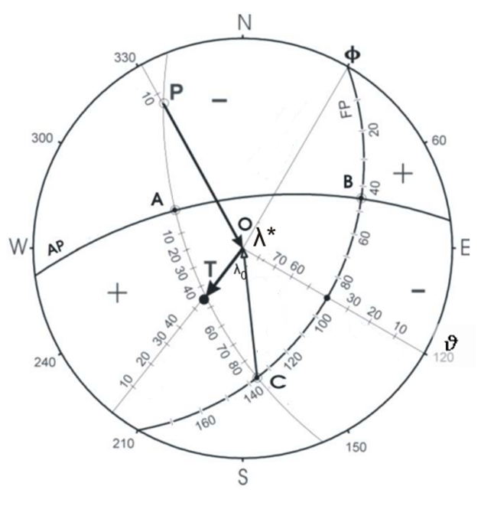
Direction
Component
Slip
vector
Dip
Kassaras & Kaviris, 2017

Slide 10
Introduction – Focal Mechanisms
How to draw a focal mechanism having φ, δ and λ
On the periphery of the circle, measure clockwise from the north φ degrees and mark the point
Rotate the overlaid paper counterclockwise until the marked point reaches the north
On the equator, measure from the east towards the focus δ degrees and mark the point
Draw the meridian that passes from the latter point. For the current exercise this is assumed to be the fault plane (FP).
On the FP, measure λ degrees from the north to the south (since the faulting is normal). This point is the C axis.
On the equator, measure 90° towards the focus. This point is the pole of the FP, i.e. the A axis.
Rotate the overlaid paper to find a meridian that crosses A and C. This is the stress plane (SP).
As in step 6, find the pole of the SP, which is the null axis B.
Measure 45° on either side of the C axis. These points are the T and P axes.
Rotate the overlaid paper to find a meridian that crosses A and B. This is the auxiliary plane AP

Slide 11
Introduction – Focal Mechanisms
To measure the azimuth and dip of a plane:
Measure the angle clockwise from the north up to the right-hand point , looking at the curved side, where the plane intersects with the periphery. This is the azimuth φ.
Rotate the overlaid paper to orient the plane N – S, with the curve pointing east. Measure the angle between the east point on the periphery and the plane. This is the dip δ.
To measure the azimuth and dip of an axis:
Draw a line connecting the focus, the axis and the periphery of the circle. The clockwise angle between the north and the periphery intersection point is the azimuth.
Rotate the overlaid paper to place the axis on the equator, closest to the east. Measure the angle between the east point on the periphery and the axis. This is the dip δ.

Slide 12
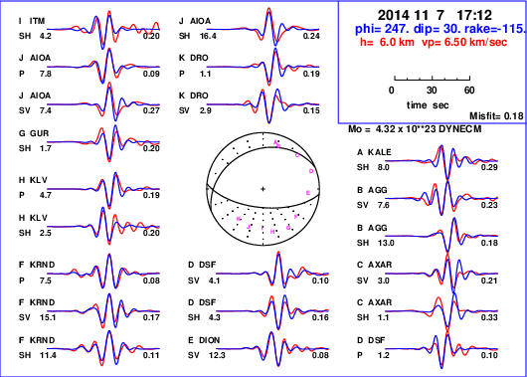
Introduction – Focal Mechanisms
A more sophisticated method requires the use of intricate code, but can provide more reliable results.
There are various techniques that utilize synthetic waves acquired by modelling, i.e. the computation of waveforms after assuming an initial source and a velocity model.
Synthetic waves are then compared to actual recorded data. Any differences are used to modify the source model and improve the synthetics, until a suitable fit between theoretical and observed data is achieved.
Methods that utilize modelling use waves that can be recorded in a wide variety of distances (local, regional or teleseismic) and, thus, do not require a dense network next to the epicenter.
Nevertheless, restrictions in the modelling process do not permit the accurate computation of some phases. As a result, such techniques only apply in earthquakes with a moment magnitude of at least roughly 3.7, so that there is adequate energy recorded by the seismometers, in the target frequencies.

Slide 13
Introduction – Magnitude and Intensity
The magnitude of an earthquake, in the broader sense, is a measure of the energy released at the source.
The computation of the magnitude is achieved through analysis of a wide variety of seismic parameters. Thus, there are different magnitude scales.
The magnitude is not the same as the intensity of an earthquake. The intensity describes the effect of an earthquake on the surface, on humans, the built and the natural environment. It is evident that intensity is not only dependent of the released energy at the source, but also on the epicentral distance and the conditions that exist on the surface (e.g. type of affected structures).
While magnitude is a singular quantity, intensity is spatially different and can vary widely. Intensity can be visualized by the use of isoseismals, i.e. contours showing its spatial distribution.
We will now look into different types of magnitude.

Slide 14
Introduction – Magnitude
Local Magnitude (M_{L}): First introduced by Richter (1935), who used amplitudes and periods of seismic waves, recorded by a Wood-Anderson seismometer, to establish a scale representing the released energy.
A simplified version of M_{L} can be retrieved by assuming that a Wood-Anderson instrument recorded a maximum amplitude A (in μm) in an epicentral distance of 100 km. Then, local magnitude can be defined as:
In practice, the hypocentral distance (R) needs to be taken into account. According to Kiratzi & Papazachos (1986), the local magnitude in Greece can be computed by the equation:
$$M_{L}=logA$$
$$M_{L}=logA+2.32logR−1.07+C_{S}$$
Station
correction

Slide 15
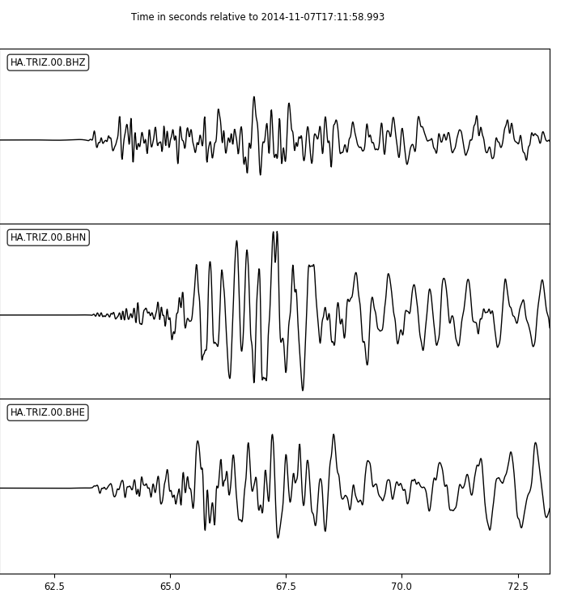
Introduction – Magnitude
The maximum amplitude of the S-waves is first determined.
Amplitude (A) is measured from the zero axis.
The mean value acquired from both horizontal components is calculated and used in the final equation (converted to μm).
A
A

Slide 16
Introduction – Magnitude
In case of a seismometer with a narrow dynamic range, the amplitude can be saturated and, as a result, the use of the local magnitude is not possible.
As an alternative, the duration of the seismic signal (d in sec) can be used to compute the duration magnitude (M_{d}). While there are equations for use with waves of longer distances (e.g. surface waves), M_{d} is usually utilized in local events. In Greece, Kaviris (2003) proposed the following relation:
where Δ is the epicentral distance in km.
Nevertheless, M_{d} is not always reliable. In many cases, it is difficult to precisely recognize the end of the signal. This can be due to high noise content in the recording or the arrival of secondary phases.
$$M_{d}=−1.1+2.35logd+0.0012Δ$$

Slide 17
Introduction – Magnitude
The arrival of P-waves is determined.
The end of the coda of the earthquake is determined.
The difference of the two is the duration that is used to calculate M_{d}.
Can you spot the problem with calculating M_{d} in the picture?

Slide 18
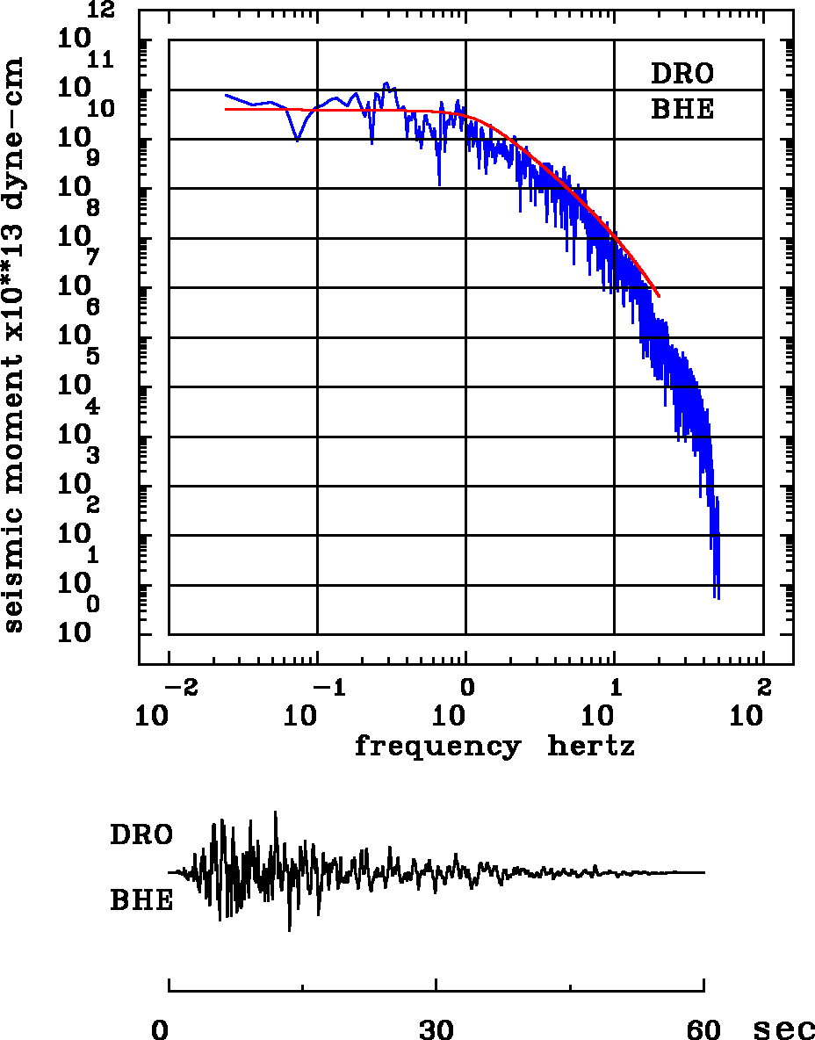
Introduction – Magnitude
To avoid the saturation of common magnitude scales, the concept of seismic moment (M₀) is used. In shear faulting, two blocks move away from each other, parallel to the fault plane. M₀ is exerted in the same direction. Aki (1966) used this to develop the moment magnitude (M_{w}) scale.
This scale effectively takes into account the spectrum of all periods, unlike M_{L}.
While M_{w} is considered more reliable than other scales, its computation can be time-consuming.

Slide 19
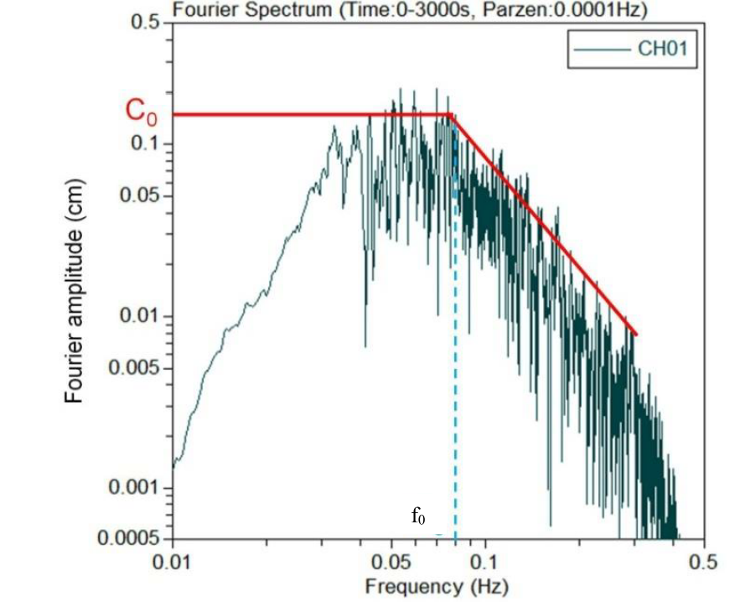
Introduction – Magnitude
Kassaras & Kaviris, 2017

Slide 20
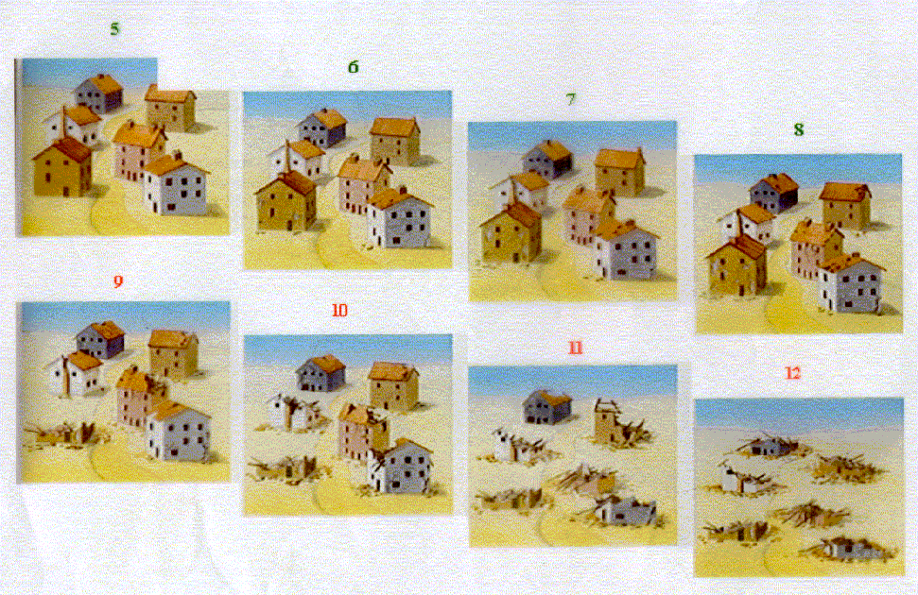
Introduction – Intensity
As with magnitudes, there is a wide variety of scales concerning intensity. The most commonly used is the European Macroseismic Scale (EMS-98).
It takes into account the building type and the earthquake effects on people, structures and the surface.
The scale has 12 grades, noted as Roman numerals, from I (not felt; not felt by anyone) up to XII (completely devastated; almost all structures destroyed, ground changes).

Slide 21
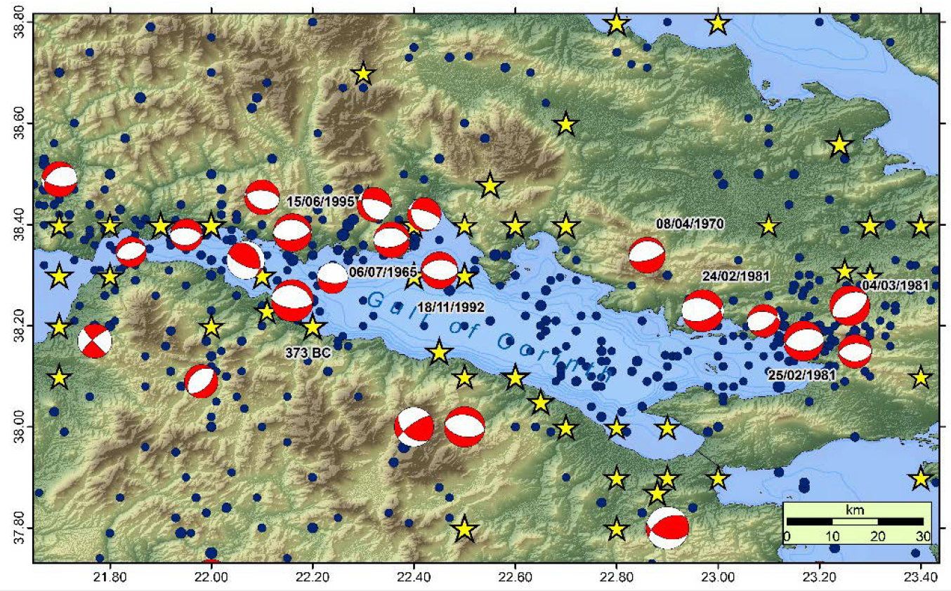
Seismicity in the Gulf of Corinth (GoC)
A “natural laboratory” for seismology and tectonics
A complex asymmetric half-graben with an (approximate) E – W orientation, dominated by normal faulting
Very active area of intraplate seismicity
The western part is far more active than the eastern
Nevertheless, significant earthquakes have been observed in both ends, with the western one being frequented by seismic swarms

Slide 22
Seismicity in the GoC
Some of the significant earthquakes that have occurred in the GoC since the antiquity:
Area | Magnitude | Year
Helike | 6.8 | 373 (B.C.)
Eratini | 6.3 | 1965
Antikyra | 6.2 | 1970
Alkionides | 6.7 | 1981
Galaxidi | 5.9 | 1992
Aigio | 6.3 | 1995
Aigio | 5.0 | 2014

Slide 23
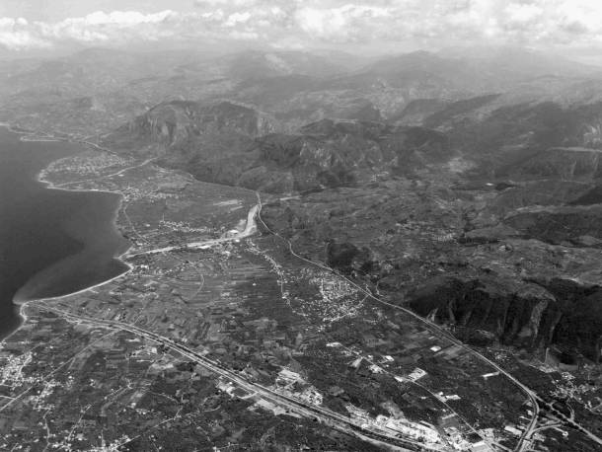
Helike (373 B.C.) – M=6.8
A winter night of 373 B.C. with a maximum intensity of X
One of the most destructive earthquakes of the antiquity
It caused the submersion of the local delta which, alongside the generated, due to a submarine landslide, tsunami (the only one for which there are strong evidence in the GoC), led to the destruction of the ancient city of Helike
Helike fault
Modern Helike delta
Soter & Katsonopoulou, 2011

Slide 24
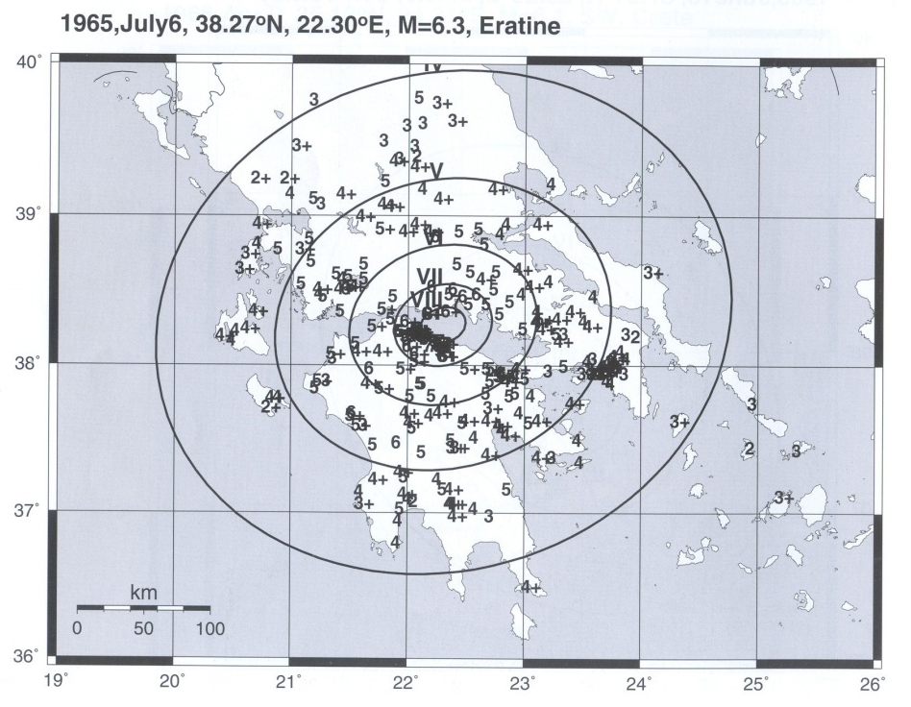
Eratini (1965) – M=6.3
03:18:42 06/07/1965 with a maximum intensity of VIII+
Surprisingly low number of aftershocks
Caused 1 fatality and 575 collapsed buildings or irreparable damages
The strongest aftershock was of a 4.1 magnitude, in the same day
The mainshock also caused numerous landslides in the GoC, as well as liquefaction phenomena (Ambraseys & Jackson, 1990).
The focal mechanism acquired from first-motion wave polarities was found to be 90°/74°/-115°, i.e. the causative fault was a E – W normal one, in accordance with the tectonic regime of the GoC (Ambraseys & Jackson, 1990)
Papazachos et al., 1997

Slide 25
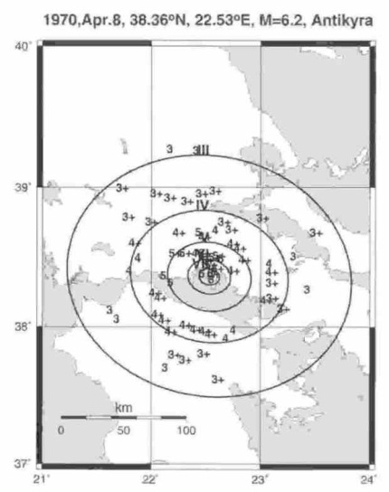
Antikyra (1970) – M=6.2
15:50:28 08/04/1970 with a maximum intensity of VII
2 collapses and 170 severely damaged buildings were recorded
The foreshock sequence started on 01/03, while the strongest event of the multiple aftershocks had a magnitude of 5.4
The earthquake had a surficial expression, with several fissures being observed near Antikyra, as well as with shifts in the roadbed elevation of the local railroad network
The focal mechanism acquired from first-motion wave polarities was found to be 90°/74°/-115°, i.e. the causative fault was a E – W normal one, in accordance with the tectonic regime of the GoC (Ambraseys & Jackson, 1990)
Papazachos et al., 1997

Slide 26
Alkionides (1981) – M=6.7
20:53:37 24/02/1981 with a maximum intensity of IX
The Alkionides earthquake sequence is one of the most important in the modern seismological history of Greece
The extended damage (as well as 20 fatalities) and the fact that it was the first, in modern times, to severely affect Athens, ushered in a new era of anti-seismic measures in the country and rekindled the interest on seismological topics
The total financial cost (including several destroyed infrastructure, like hotels and factories) was up to 1.4 billion € (adjusted for inflation) (Ambraseys & Jackson, 1990)
The mainshock was followed by two strong events on 25/02 (M=6.4) and 04/03 (M=6.3)
Damage type | Number of affected buildings
Irreparable | 22,554
Major | 11,745
Minor | 50,222

Slide 27
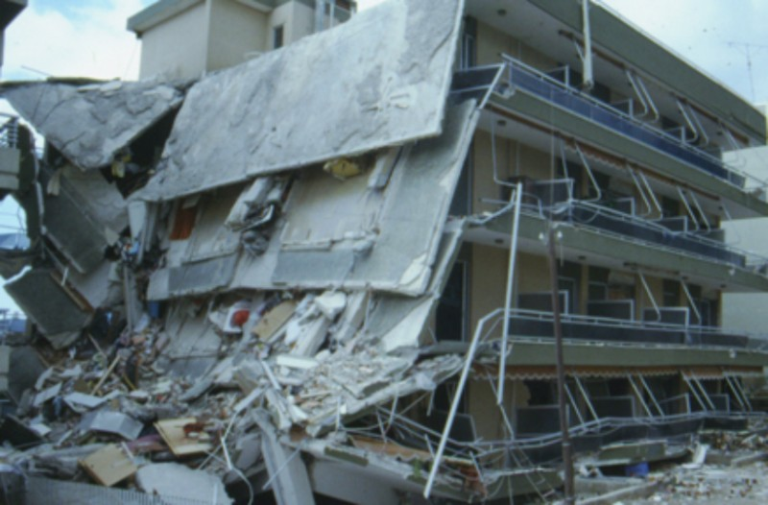

Slide 28
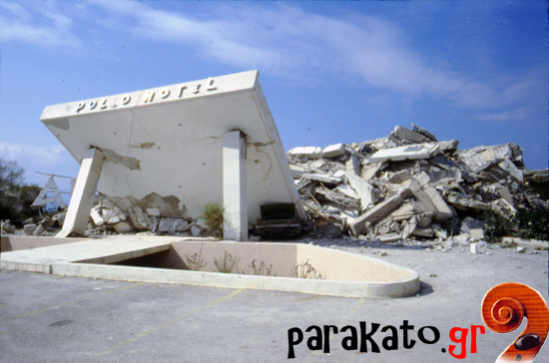

Slide 29
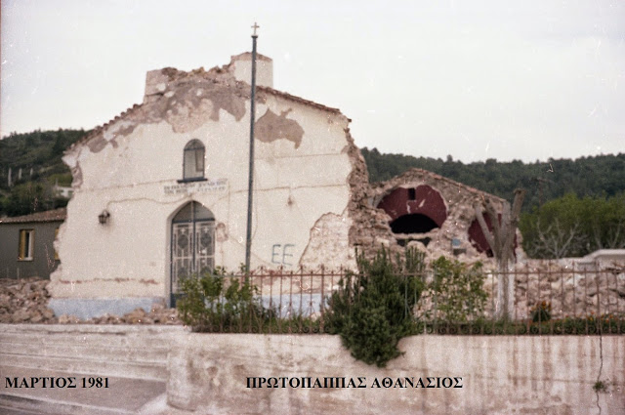

Slide 30
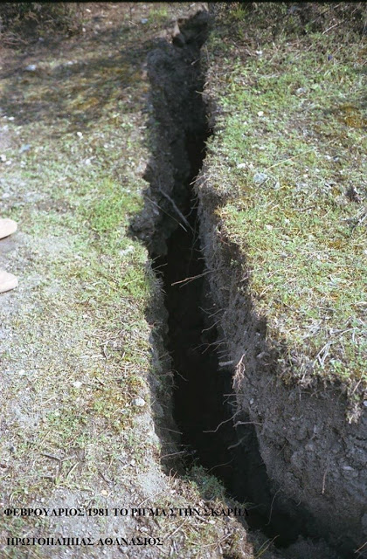
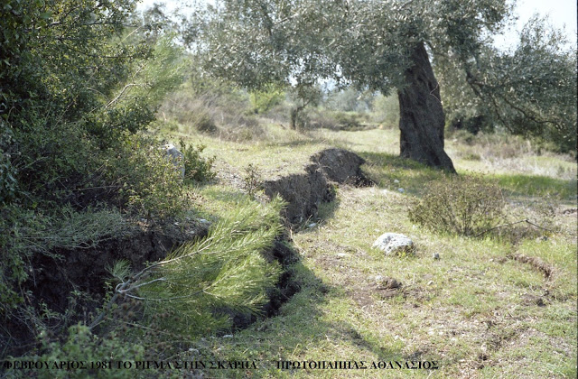

Slide 31
Alkionides (1981) – M=6.7
After the first mainshock, the fault trace could be observed, with a length of over 15 km and a slip of 60 cm
Secondary phenomena (liquefaction, landslides and a weak sea wave) were present
The focal mechanism was found equal to 285°/40°/-70° for the 24 February, 250°/42°/-80° for the 25 February and 68°/47°/-82° for the 4 March events, respectively.

Slide 32
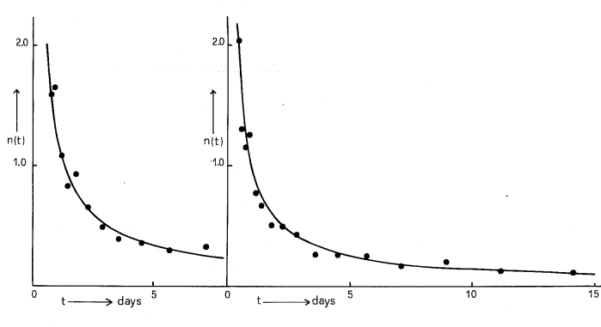
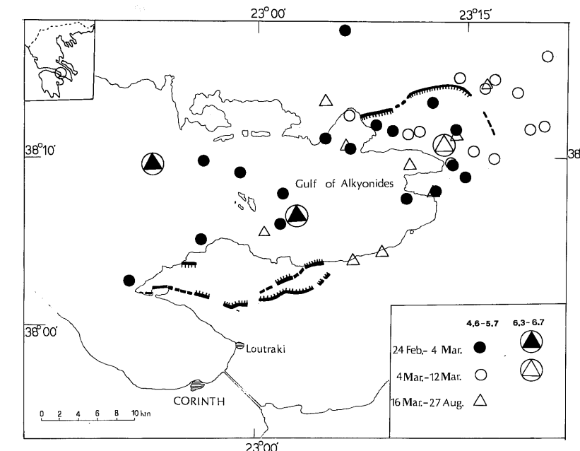
Alkionides (1981) – M=6.7
The sequence is subdivided into two distinct subsequences, one starting with the “main” M=6.7 shock on 24/02 and another starting with the M=6.3 event of 04/03.
A western and eastern epicentral area (corresponding to the February and March subsequences) can be observed, separated by an aseismic zone.
February
March
Papazachos et al., 1983

Slide 33
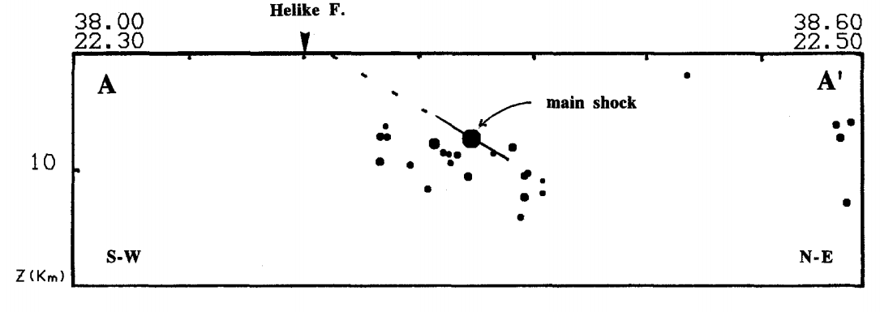
Galaxidi (1992) – M=5.9
21:10:00 18/11/1992
As in the case of the 1965 Eratini event, the aftershock sequence was not significant. The maximum aftershock magnitude was equal to 3.1 (25 earthquakes with M > 4.0 were expected).
The focal mechanism was found to be 270°/30°/81°
A cross-section of the located events of the sequence indicates a north dipping plane, corresponding to the Helike fault.
The junction between the Helike and the nearby Xilokastro faults functions as a barrier.
Hatzfeld et al., 1996

Slide 34
Aigio (1995) – M=6.2
00:15:49 24/02/1981 with a maximum intensity of VIII
Even though the earthquake was located at the northern side of the GoC, it caused massive damage in the city of Aigio (located on the southern side).
A total of 4,367 buildings were severely damaged and 26 casualties were reported.
The event caused the appearance of fissures.
The focal mechanism was found to be 277°/33°/-77°
Note the surprising low dip angle!

Slide 35
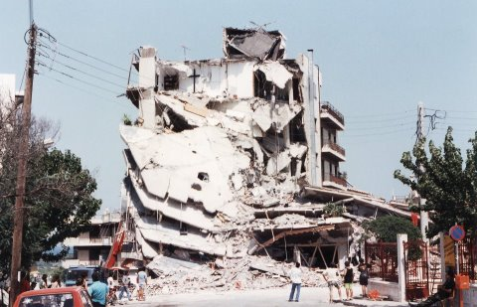
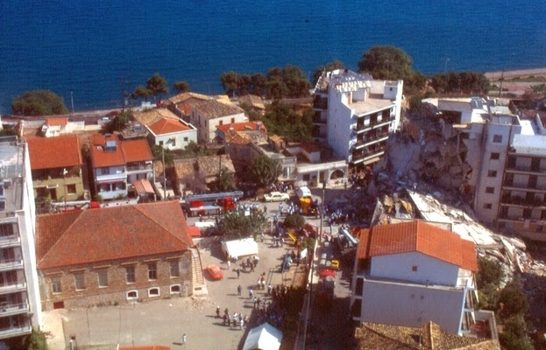
Aigio (1995) – M=6.2

Slide 36
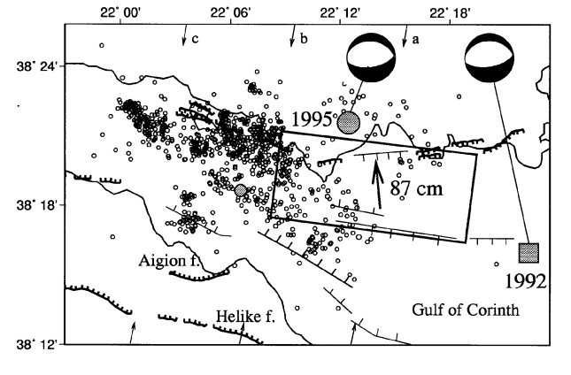
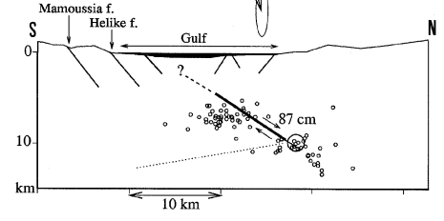
Aigio (1995) – M=6.2
There were damages in the northern coast of the GoC, near the epicenter, and the effects in Aigio were significant. This is attributed to the directivity of the S-waves generated by the event, a result of the southward propagating rupture.
The low dip angle does not correspond to other known faults in the GoC, implying that this fault is either a rare occurrence or the very first evidence of a newly started activity in the centre of the rift.
Bernard et al., 1997

Slide 37
Aigio (2014) – M=5.0
17:12:59 07/11/2014 with a maximum intensity of VI
It caused minor non-structural damage
Nevertheless, this is the most significant earthquake in the area since 1995.
The focal mechanism was found to be 247°/30°/-115°. This points to a similar low-angle fault as in the case of the 1995 event

Slide 38
Seismic Hazard
Seismic hazard describes the potential of an area for experiencing dangerous phenomena associated with earthquakes (e.g. violent ground motions, fissures, liquefaction).
According to Lomnitz (1974), it is “the possibility P(M,A,V,D) for an earthquake of a specific magnitude M or ground motion (e.g. acceleration A, velocity V or displacement D, or even intensity I) to occur in the study area within a specified time period T”.
Seismic risk is the estimate of the possibility of damages due to an earthquake. Seismic risk ($SR$) can be defined as a combination of seismic hazard ($SH$), vulnerability ($VL$) and the endangered cost ($EC$):
$$SR=SH∗VL∗EC$$

Slide 39
Seismic Hazard
The parameters that define seismic hazard can be computed by Ground Motion Prediction Equations (GMPEs). GMPEs take into account a multitude of parameters (e.g. epicentral distance, magnitude, ground conditions and focal mechanisms) to provide an estimate of A,V,D in a specific point of interest.
Examples of GMPEs (Skarlatoudis et al., 2003):
$logPGA=0.86+0.45M−1.27\log{\sqrt{\left(R^{2}+h^{2}\right) }}+0.10F+0.06S±0.286$
$logPGV=−1.47+0.52M−0.93\log{\sqrt{\left(R^{2}+h^{2}\right) }}+0.07F+0.11S±0.303$
$logPGD=−4.08+0.88M−1.27\log{\sqrt{\left(R^{2}+h^{2}\right) }}−0.02F+0.25S±0.424$
where $M$ the magnitude, $R$ the epicentral distance, $h$ the focal depth, $F$ the type of the focal mechanism and $S$ the local site conditions.

Slide 40
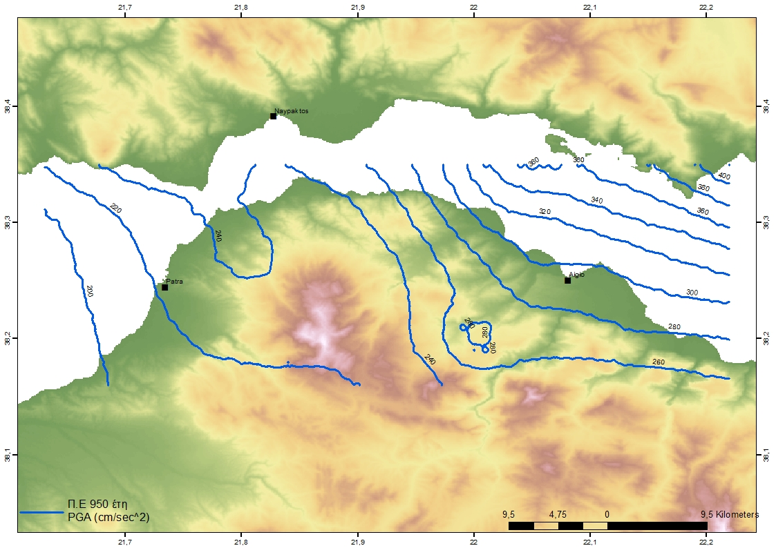
Seismic Hazard in the GoC
Peak Ground Acceleration
Return Period: 950 years
Highest values are concentrated towards the eastern part

Slide 41
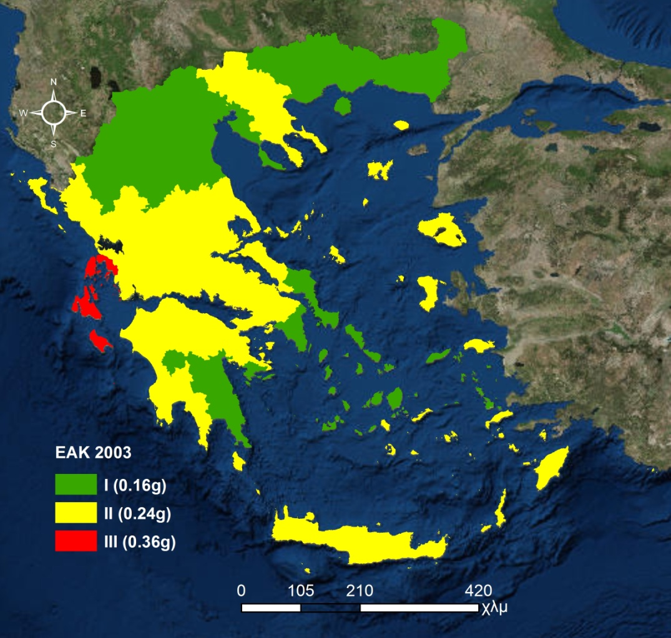
Greek Seismic Design Code
Studies of seismic hazard in Greece have led to the creation of the Greek Seismic Design Code, (GSDC) most recently revised in 2003 (EAK, 2003).
As new research surfaces and new constraints are discovered, the GSDC is constantly revised.
According to the GSDC, the country is divided into 3 zones. Each zone is characterized by a peak ground acceleration value with a 10% possibility of non-exceedance in the next 50 years, i.e. a return period of 475 years.
The GoC belongs in zone II, where a maximum acceleration of 0.24g (i.e. 2.35 m/s²) is expected.

Slide 42
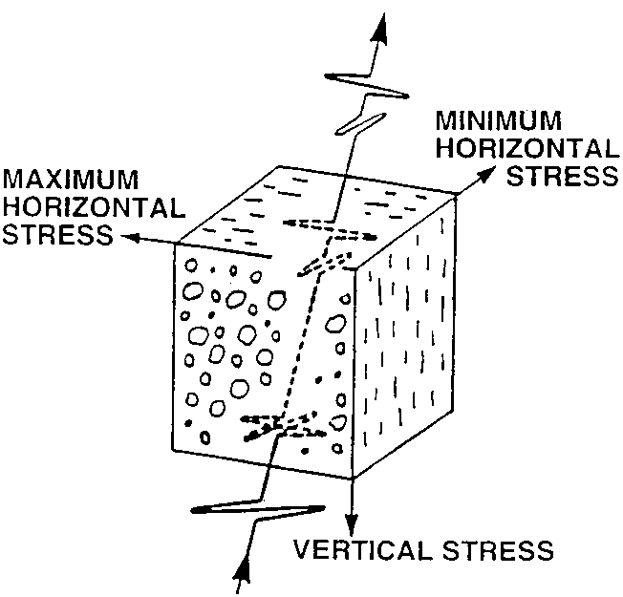
Applications of CRL – Seismic Anisotropy
Seismic anisotropy: the phenomenon where the velocity of the shear-waves is dependent of the polarization direction
Two distinct components are produced: the higher velocity S_{fast} and the lower velocity S_{slow}
In areas with fluid-saturated microcracks (as in the GoC), the polarization direction of the S_{fast} ($φ$) is parallel to the regional maximum horizontal stress component ($S_{Hmax}$).
For normal faults, $S_{Hmax}$ is oriented in the same direction as the fault strike.

Slide 43
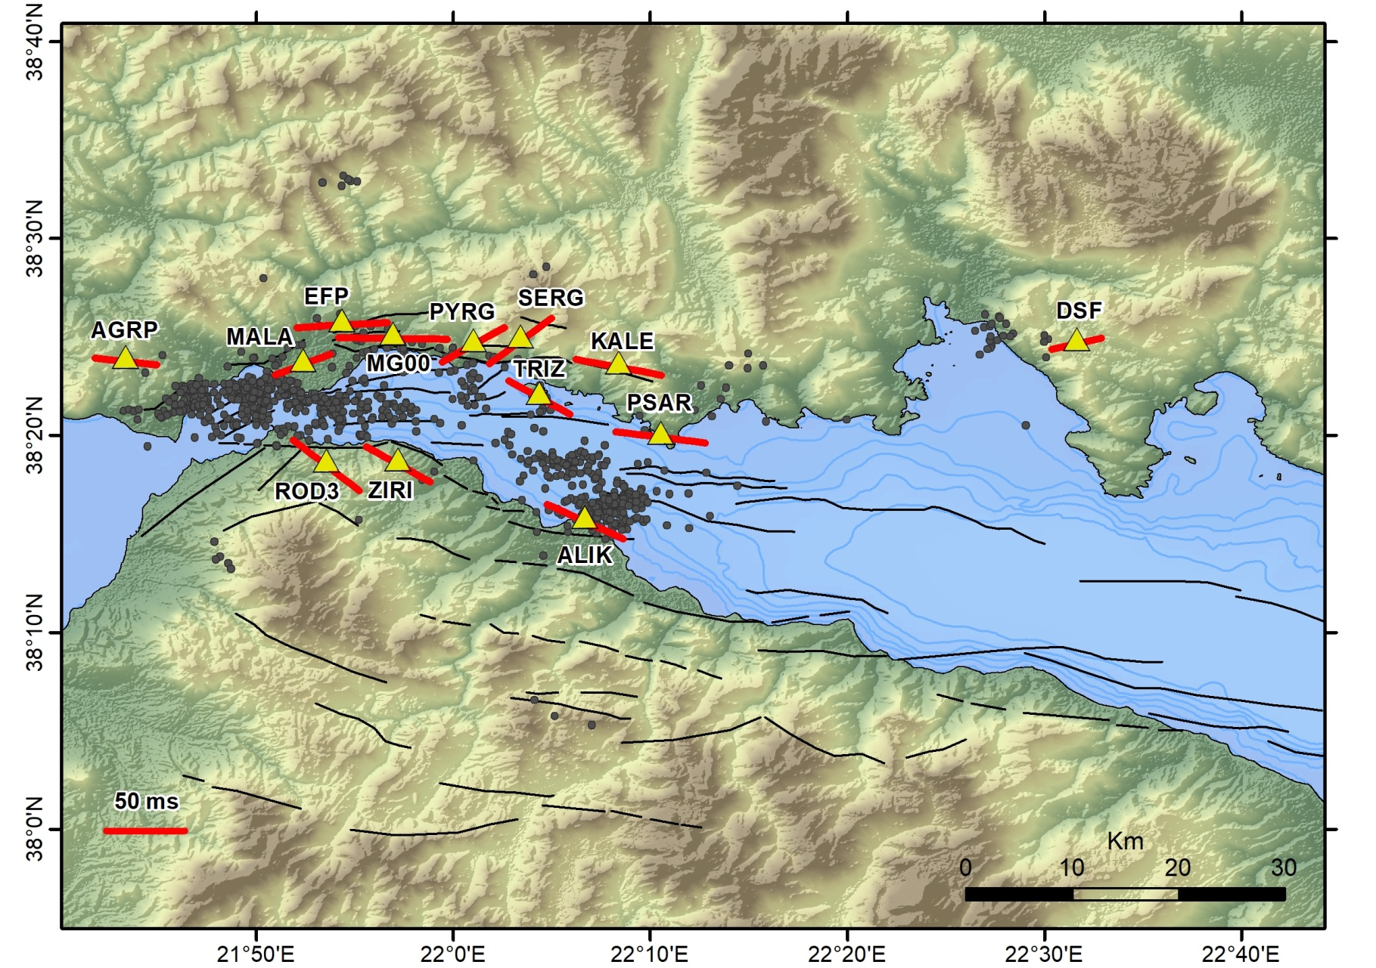
Applications of CRL – Seismic Anisotropy
In the GoC, φ is aligned according to the $S_{Hmax}$, in a general WNW – ESE direction.
In places with deviating values (e.g. SERG and PYRG stations), seismic anisotropy could reveal the existence of faults or structures with similar orientation, that overpower the regional stress field.

