Slide 1
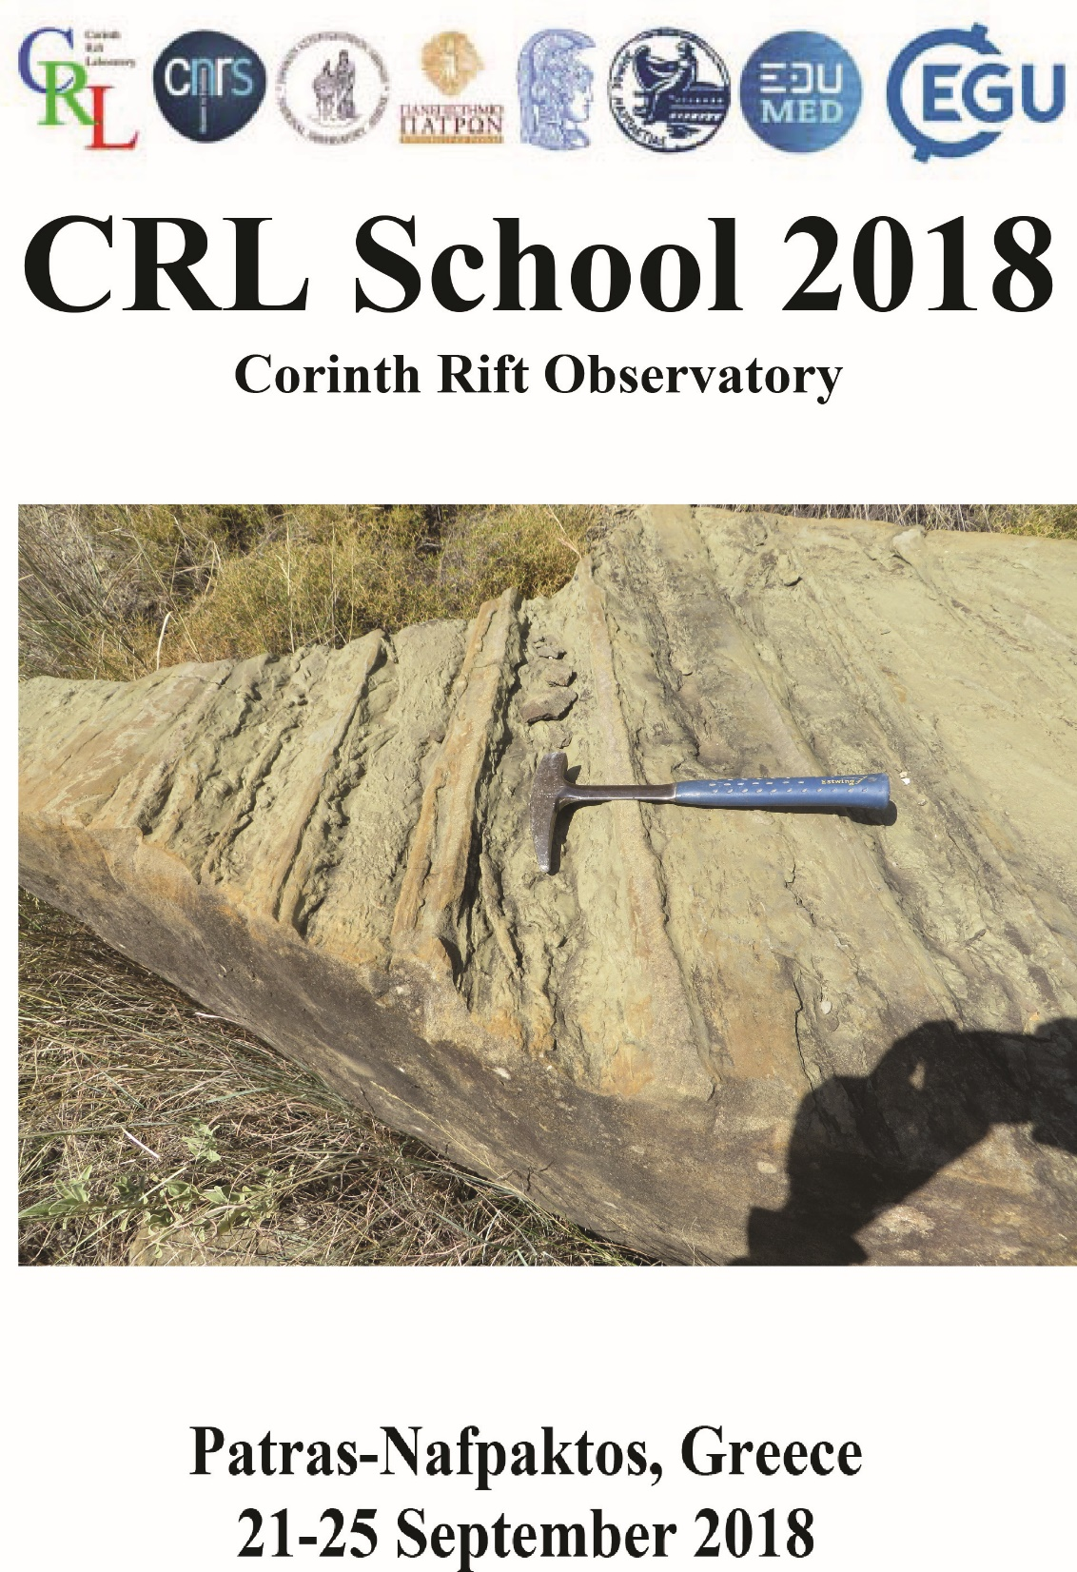
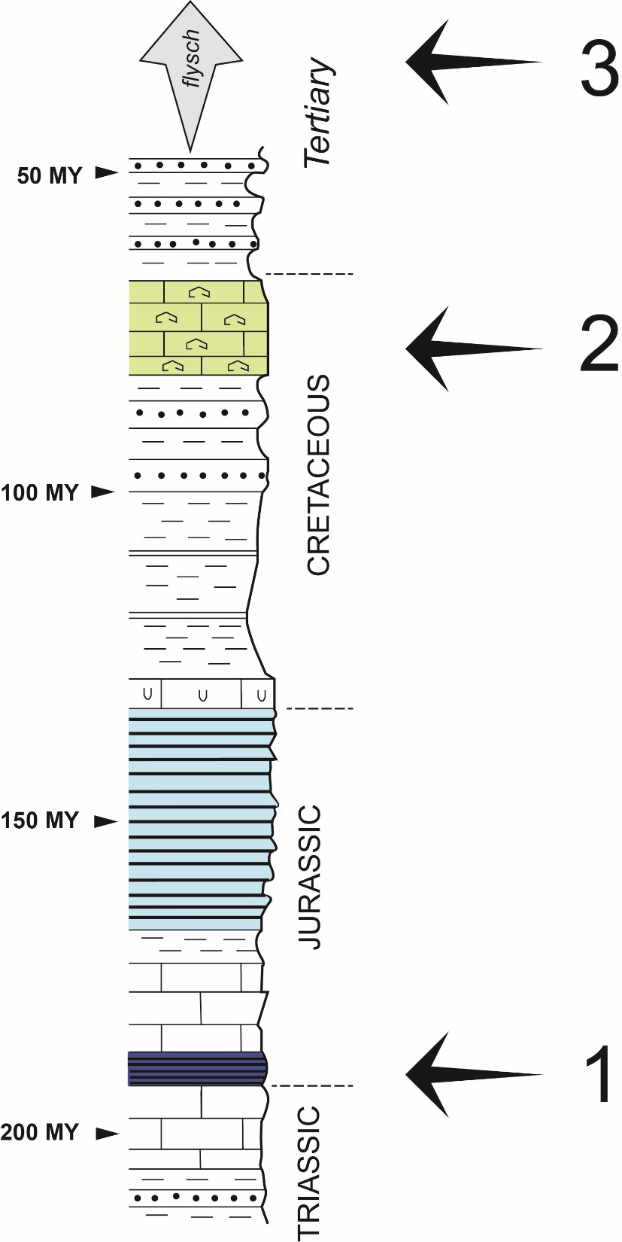
Discussing
the origin
of ryhmicity
and/or cyclicity
of few outcrops
around Nafpaktos

Slide 2
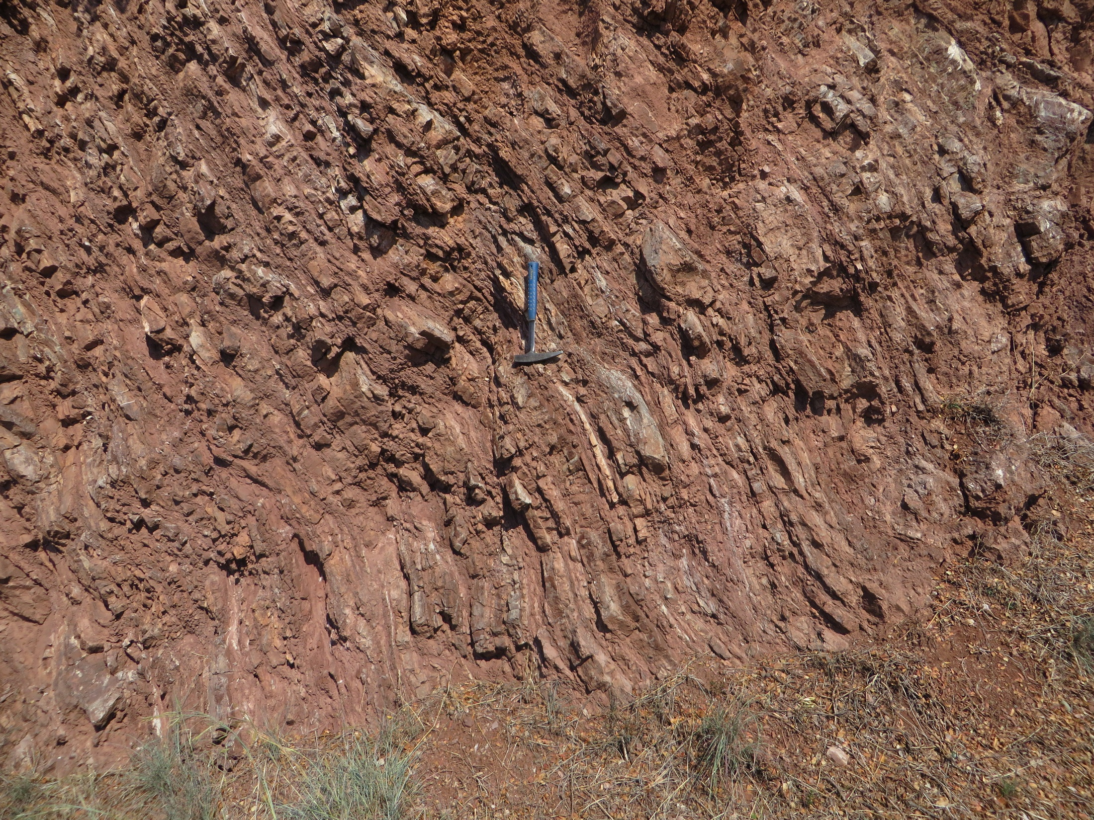
1
?

Slide 3
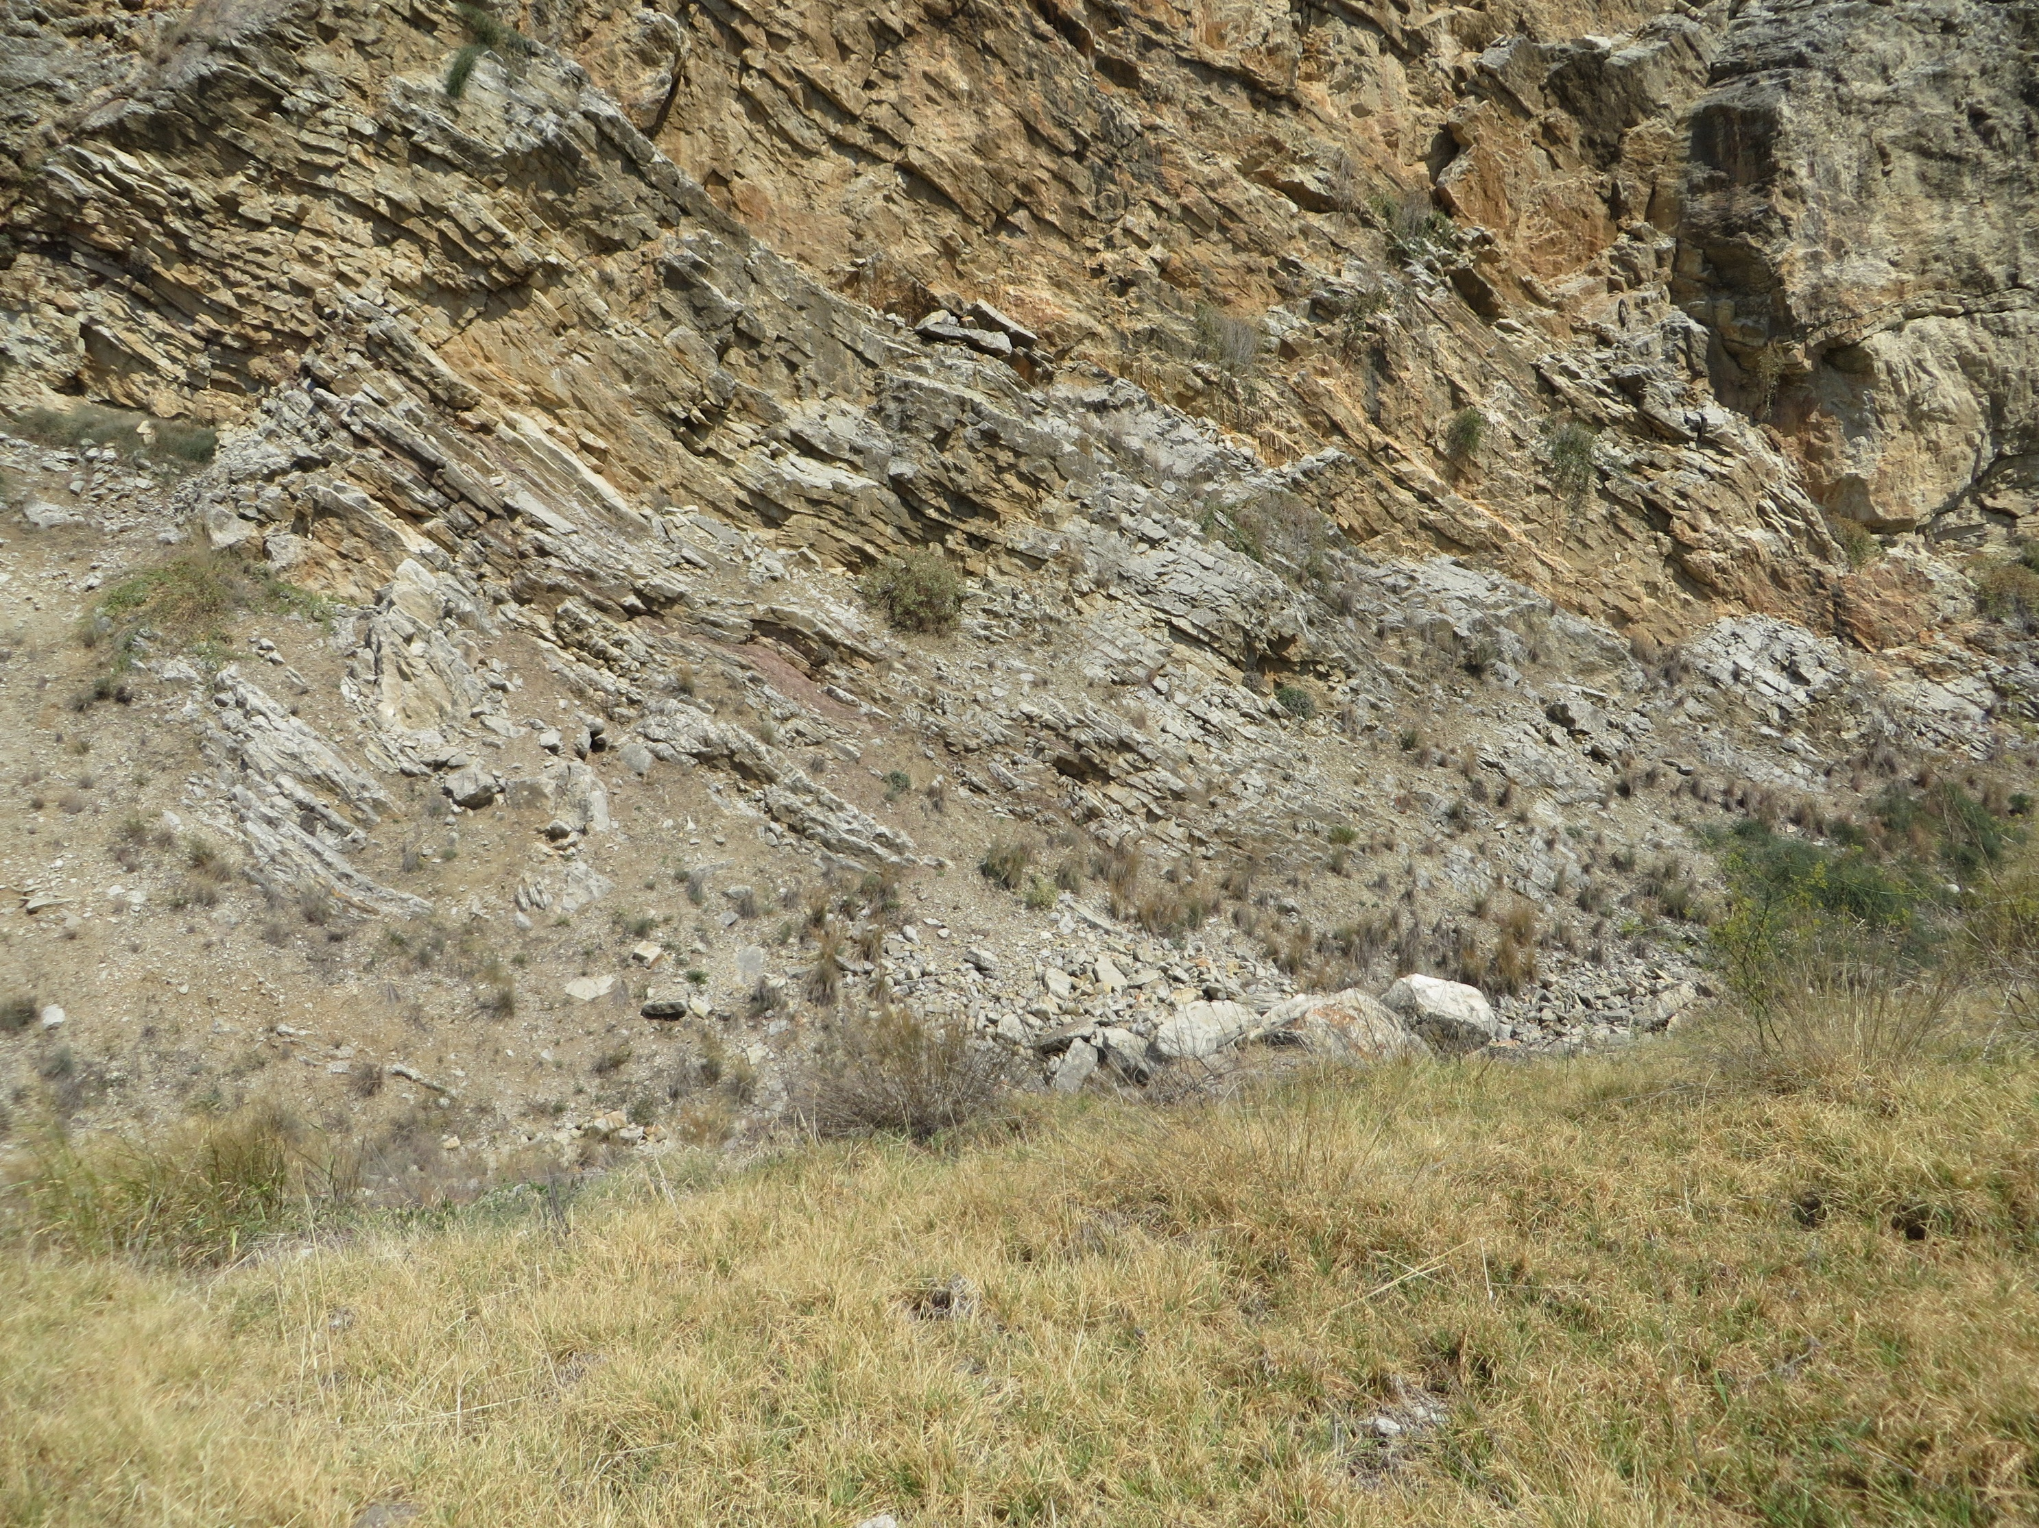
?
2

Slide 4
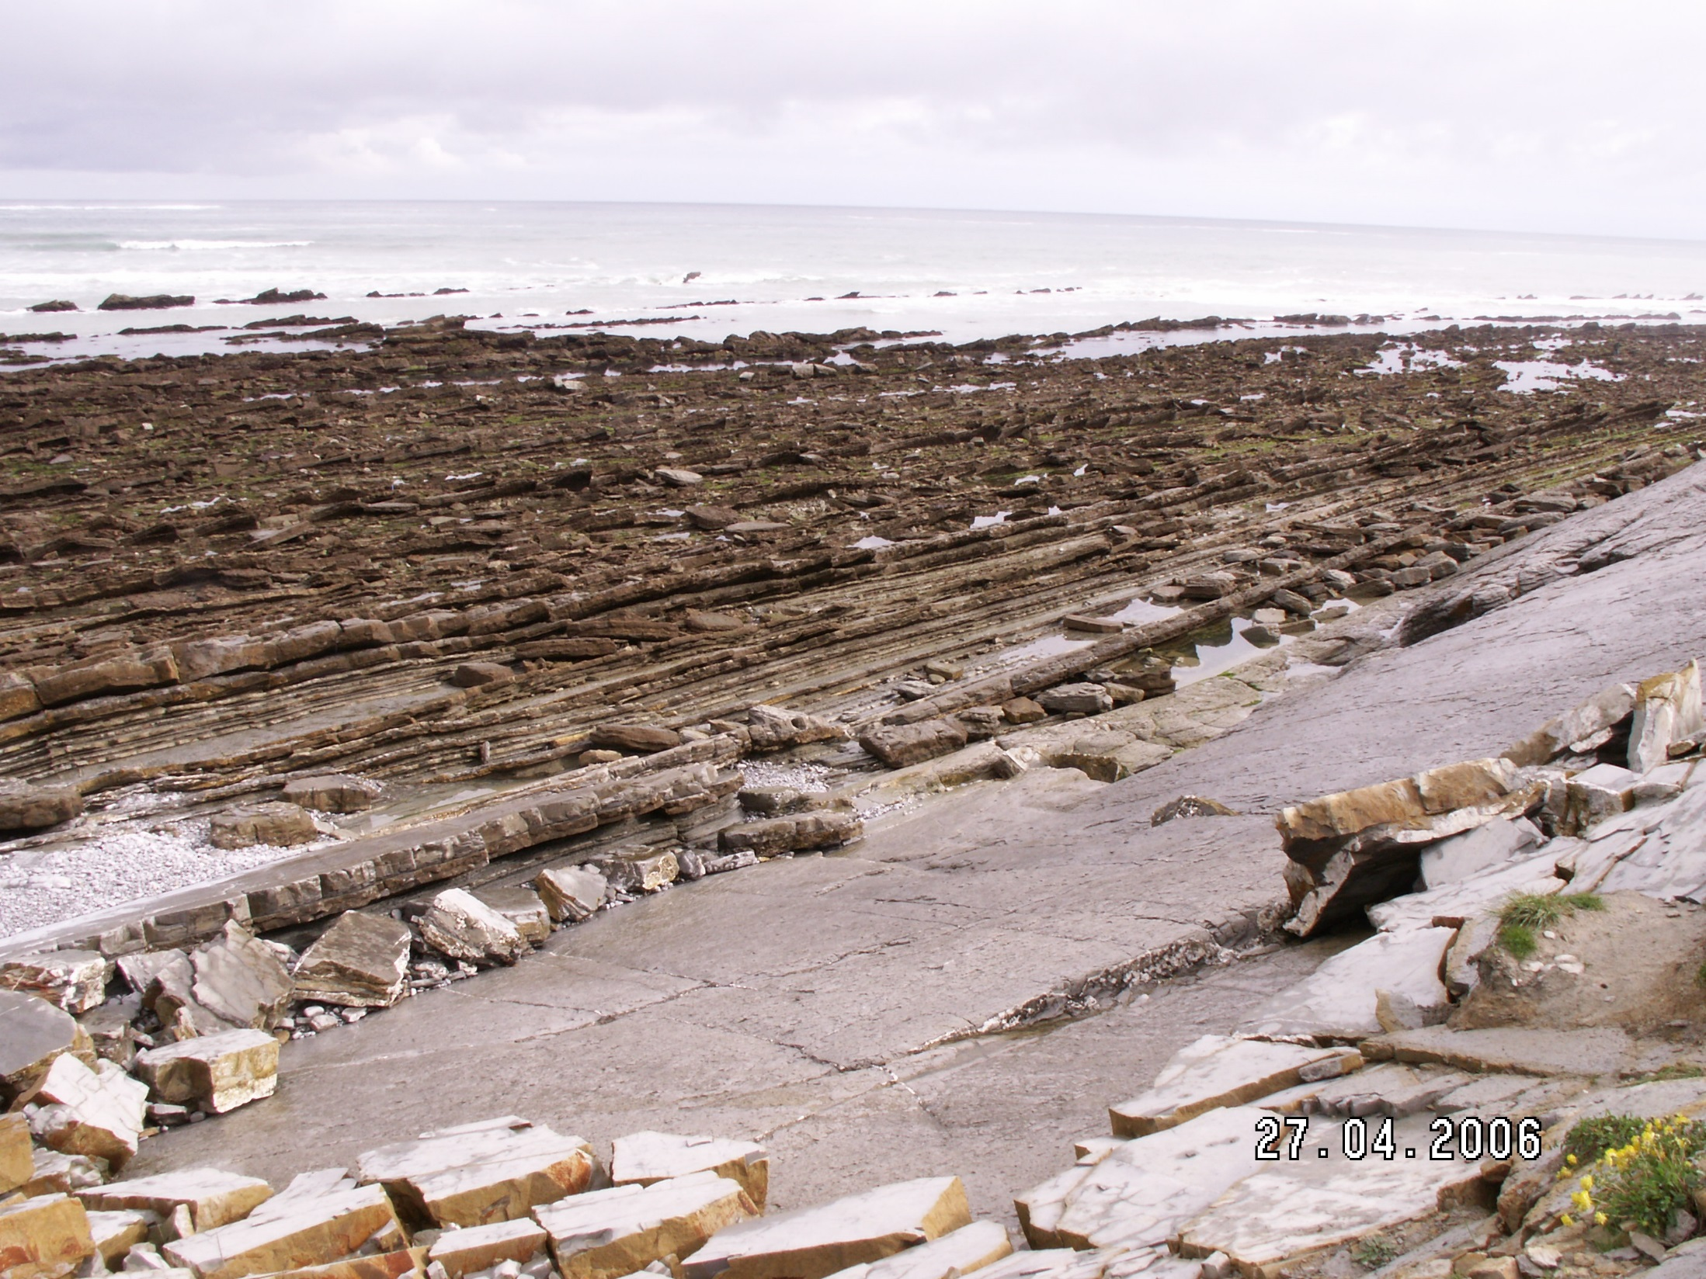
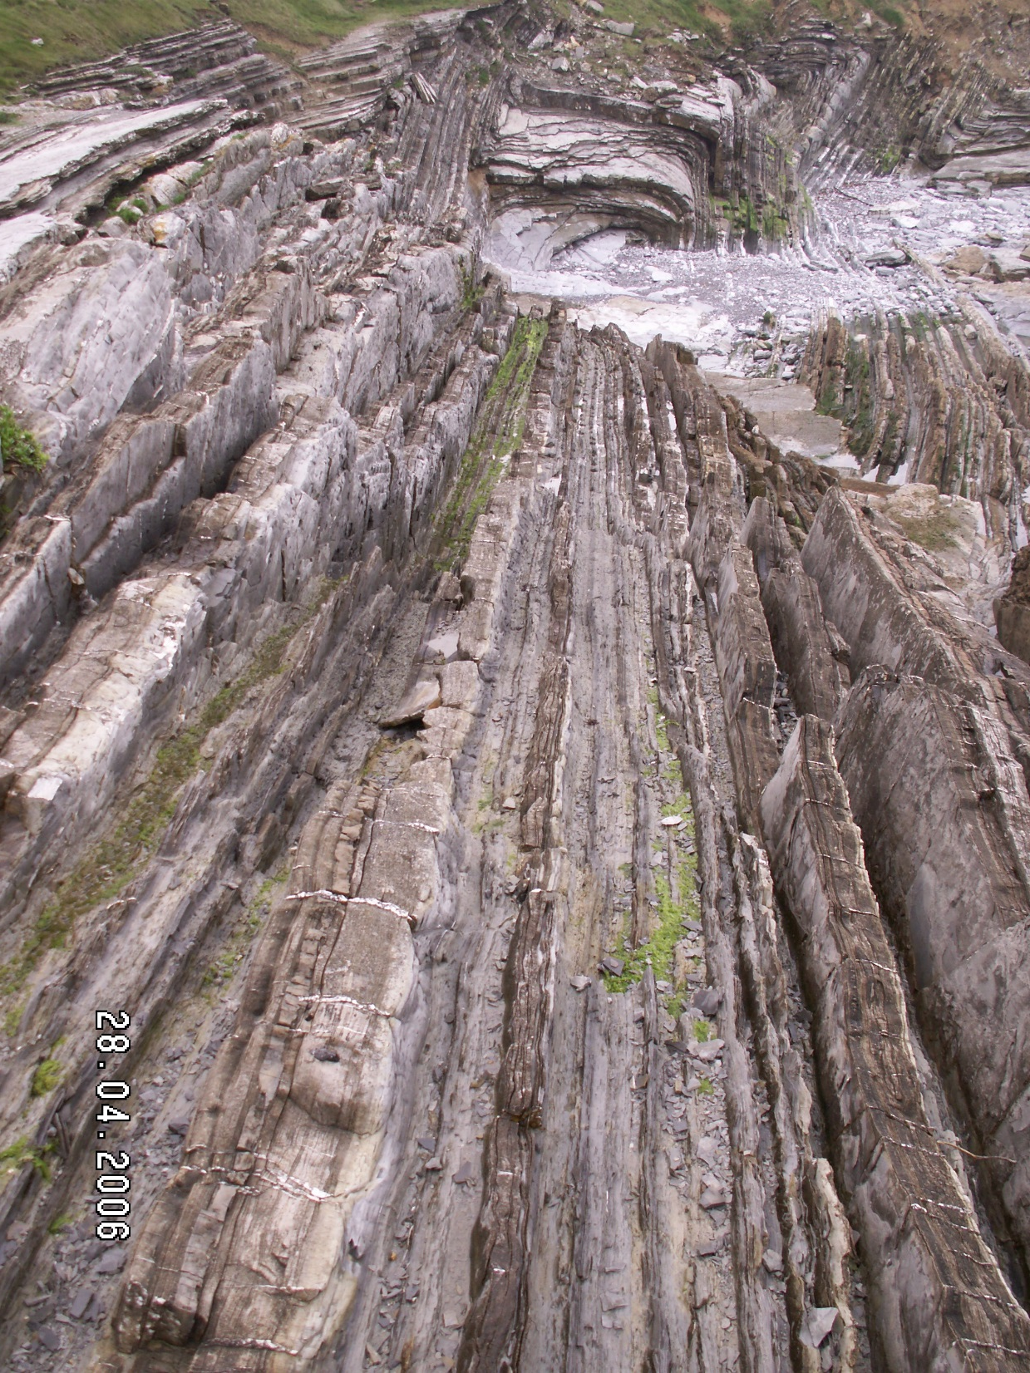
sandstones, calcareous mudstones, marls, etc.
Anglet, St Jean de Luz, Ciboure, NW spanish coast

Slide 5
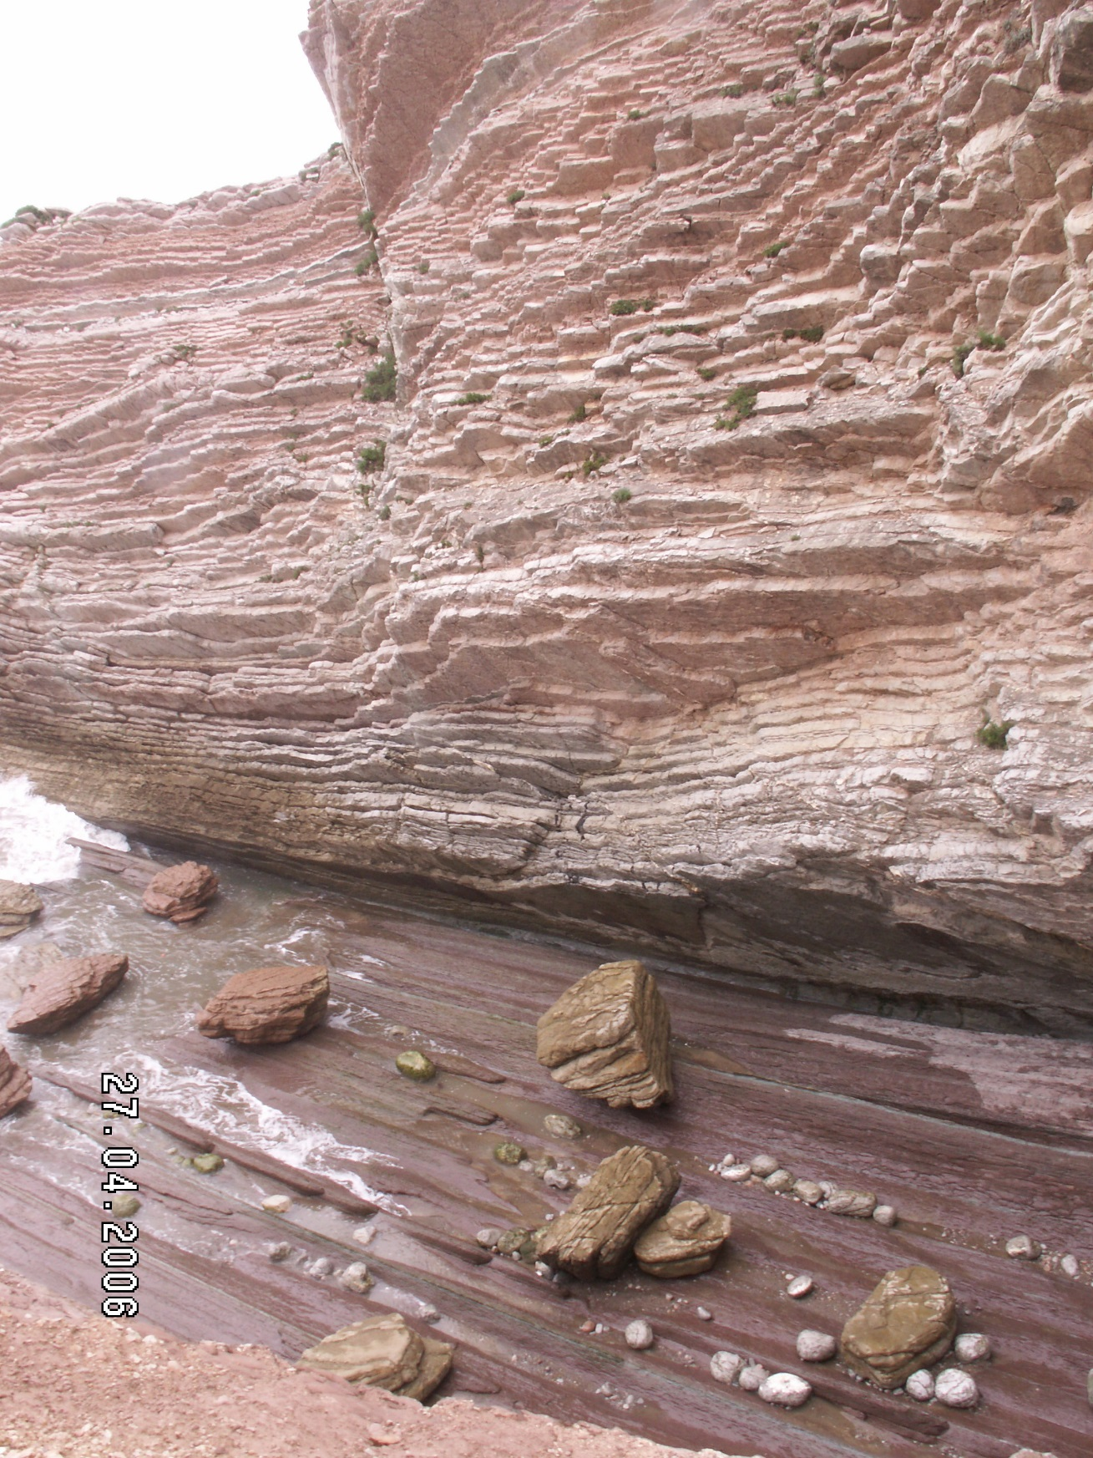
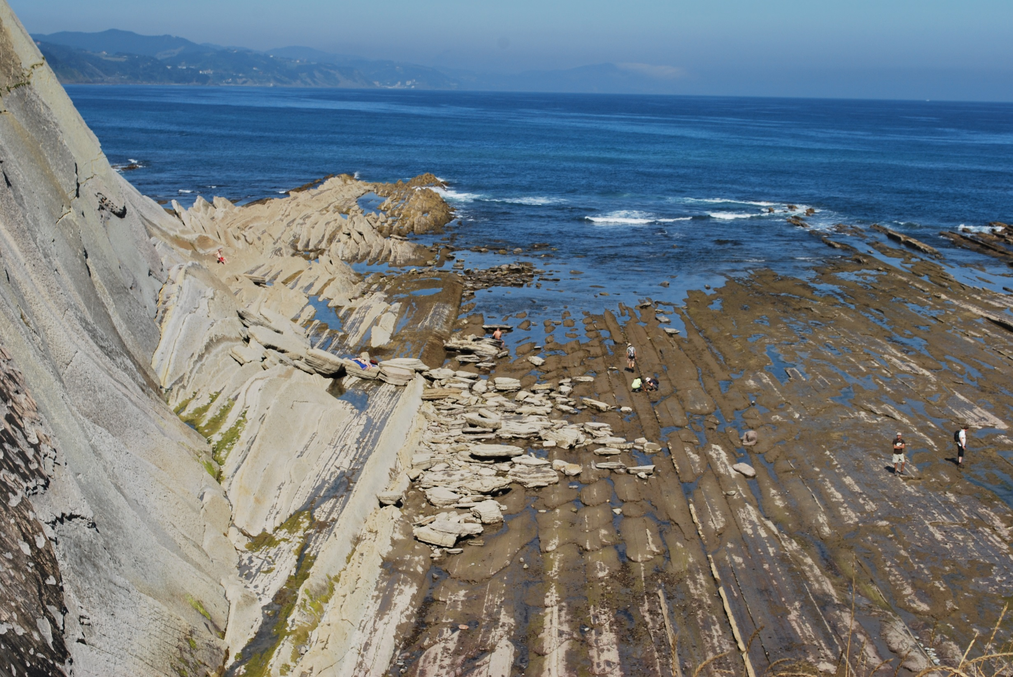
Alternances régulières calcaire argileux / marne
Plus au Sud, Zumaïa
Cretaceous / Tertiary
« KT » boundary
- 65 M.Y.

Slide 6
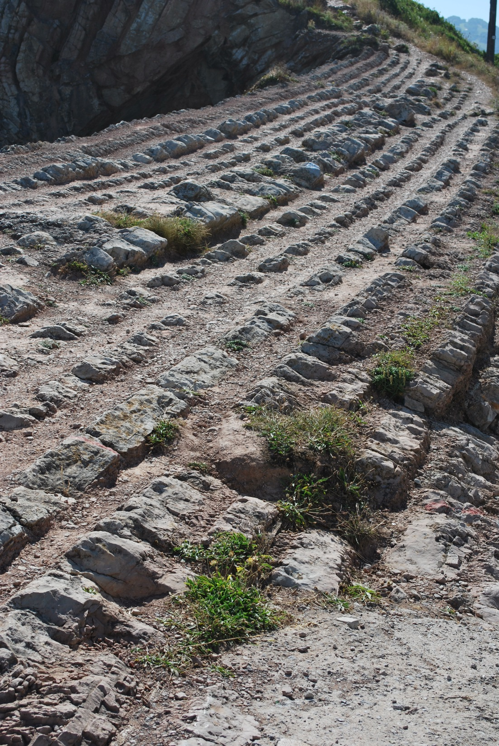
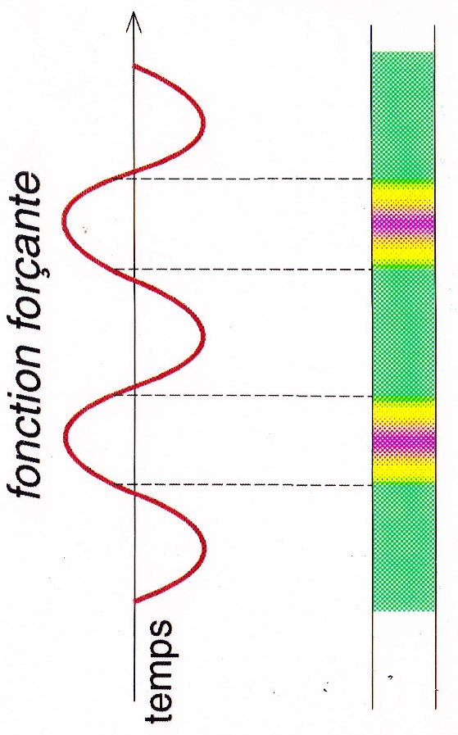
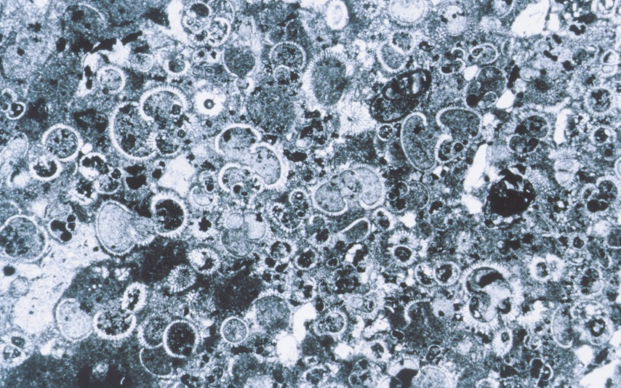
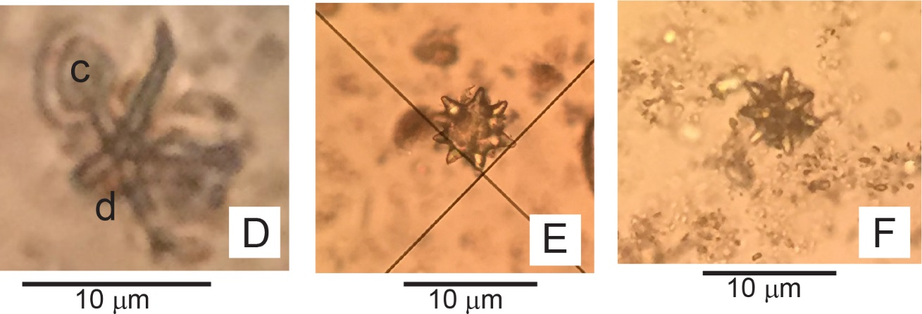
detail: transition from limestone (fine-grained/micritic) to marls
1 mm
Driving (« forcing ») function
+
clay
plancton and calcareous nannoplancton
(bio-production)
+

Slide 7
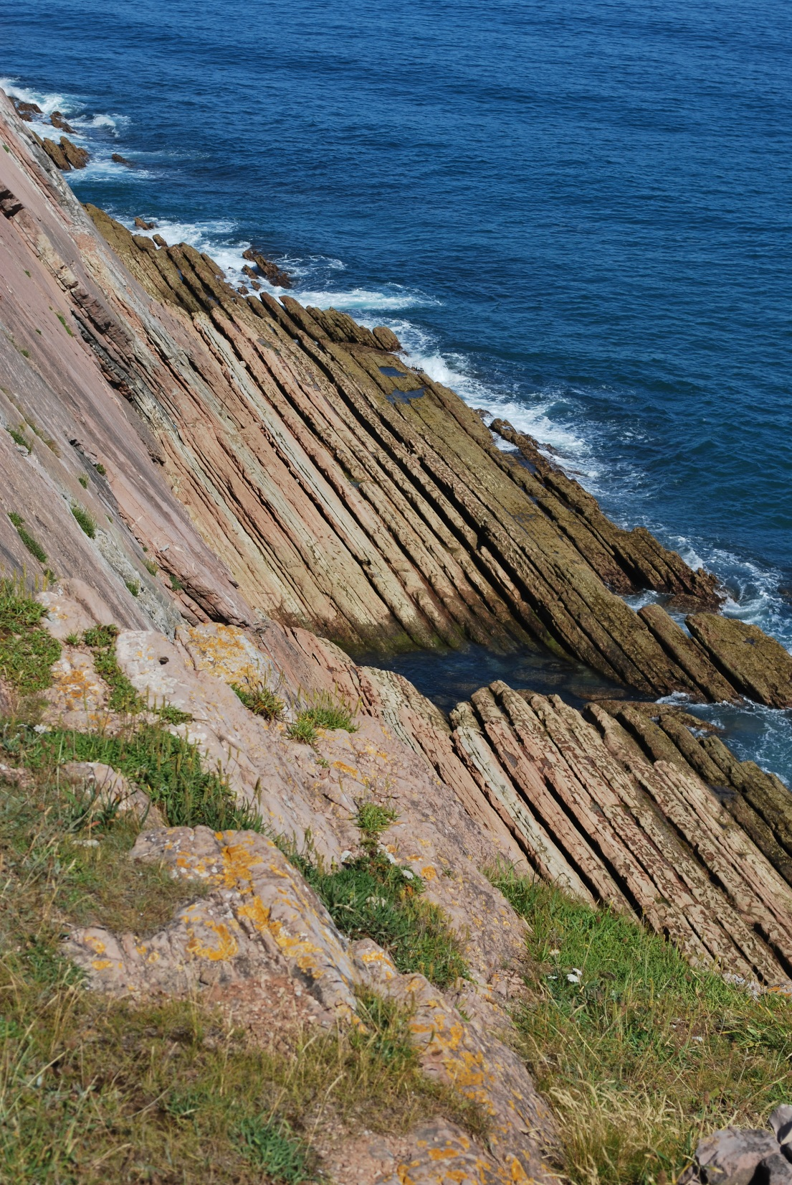
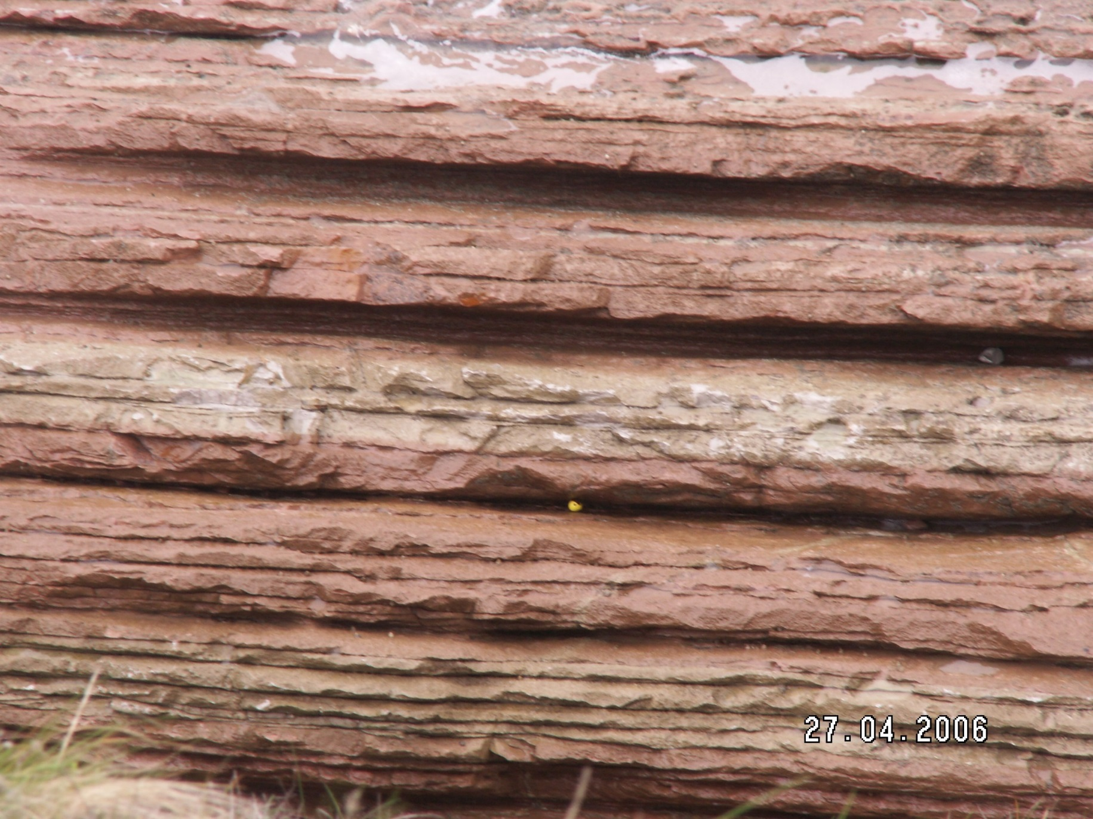
1 m
rythmicity + cyclicity: combined alternances
groups of 5 (most frequent) first order alternances (10 à 20 cm thick)

Slide 8
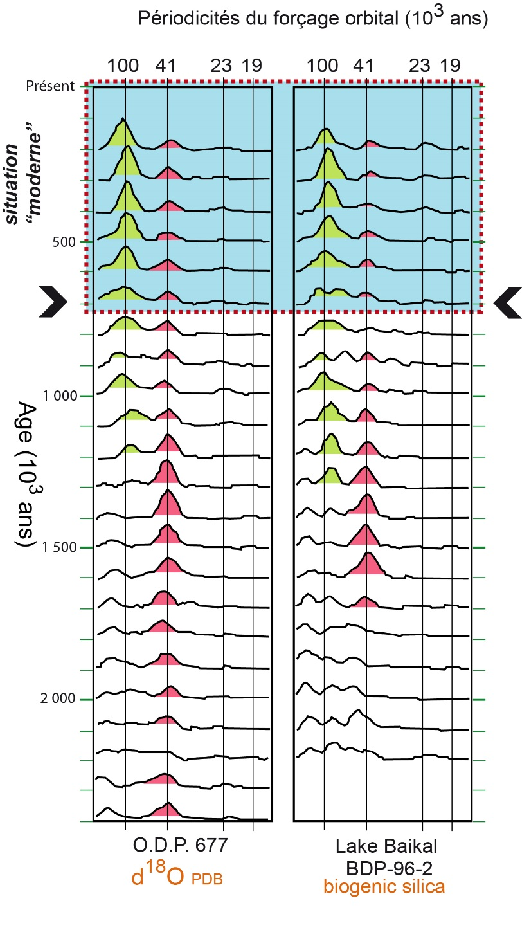
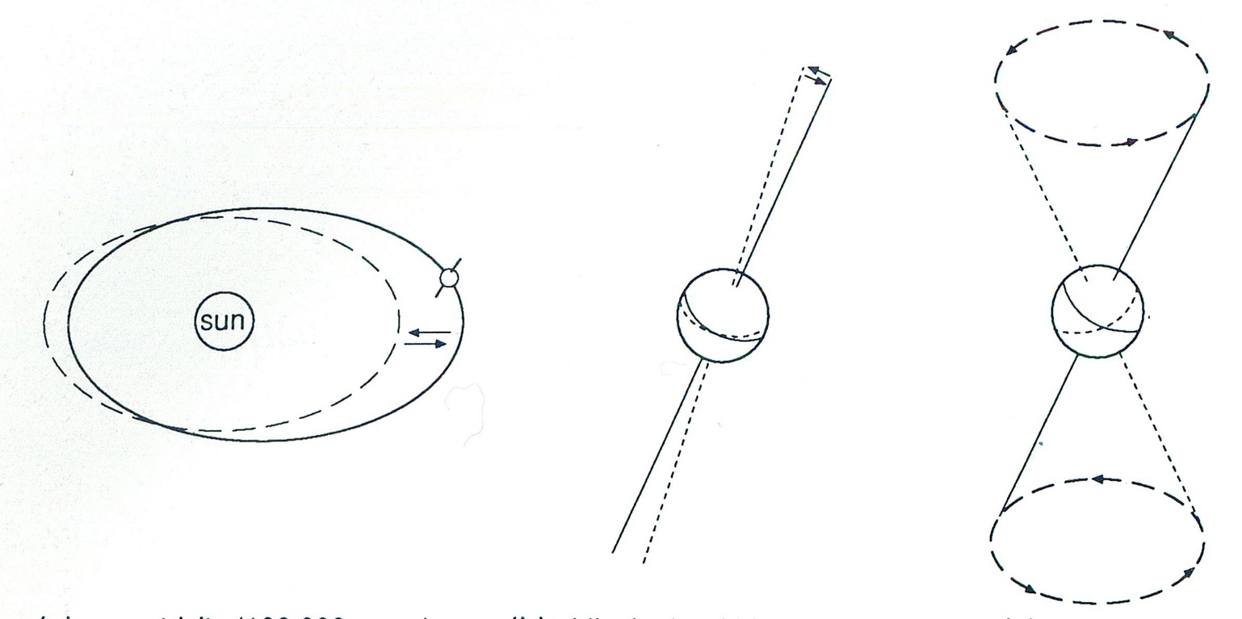
Climatic cycles with astronomic driving (« orbital ») area weell defined
for a recent period through glacial / interglacial episodes
( Milankovitch cycles)
Present
glaciations
deglaciations
- 1M.Y.
Two well-defined periodicities
driving global climate:
100 000 years et 41 000 years
- 2 M.Y.
Excentricity
(100 000 ans)
Climatic fluctuations (stables isotopes)
Inclination
(41 000 ans)
- 3 M.Y.
precession
(19 000
and 23 000 years)

Slide 9
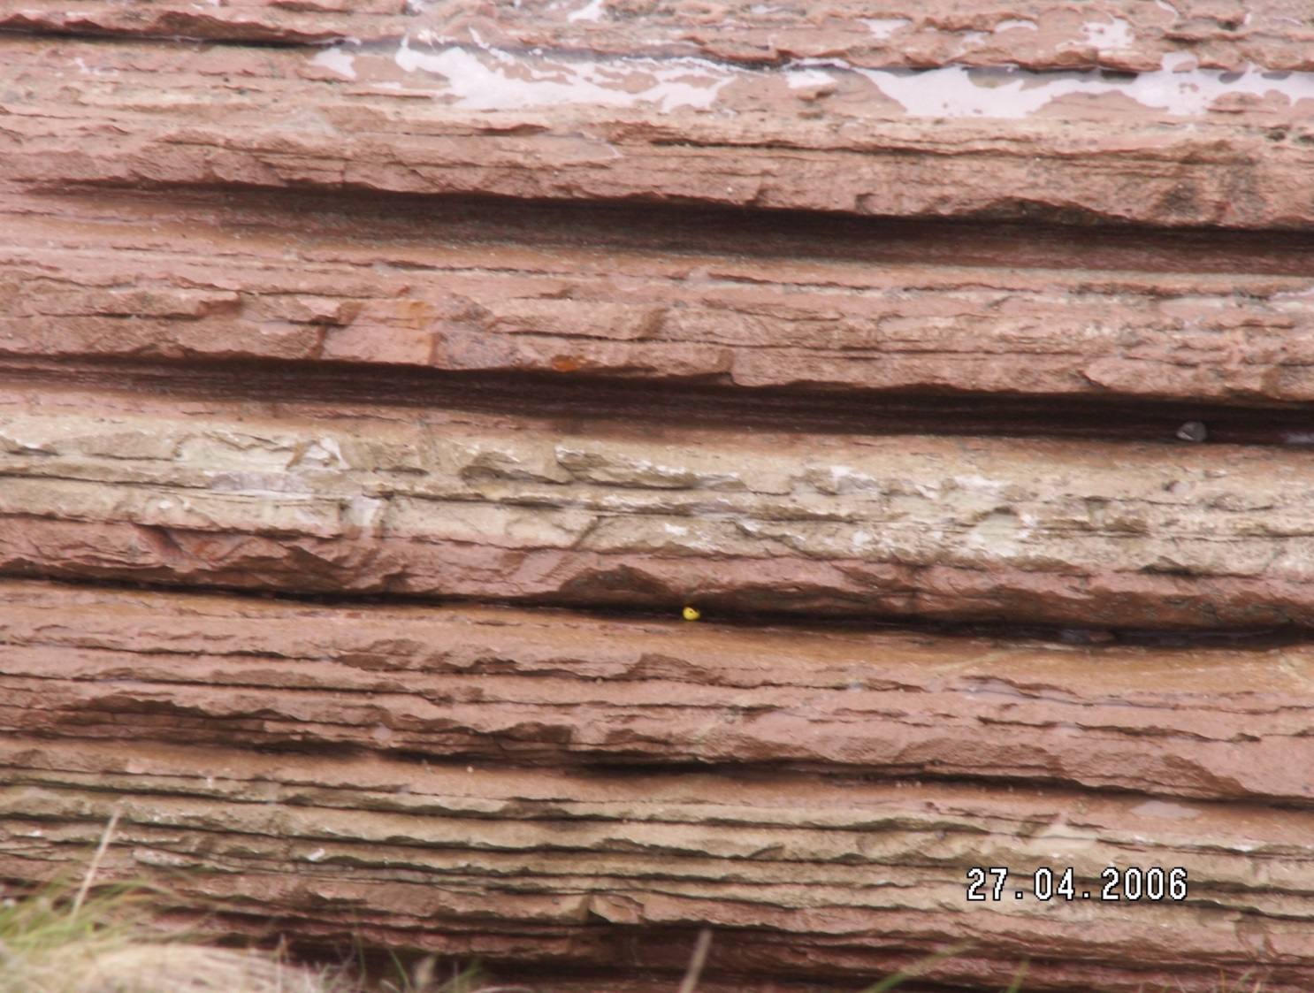
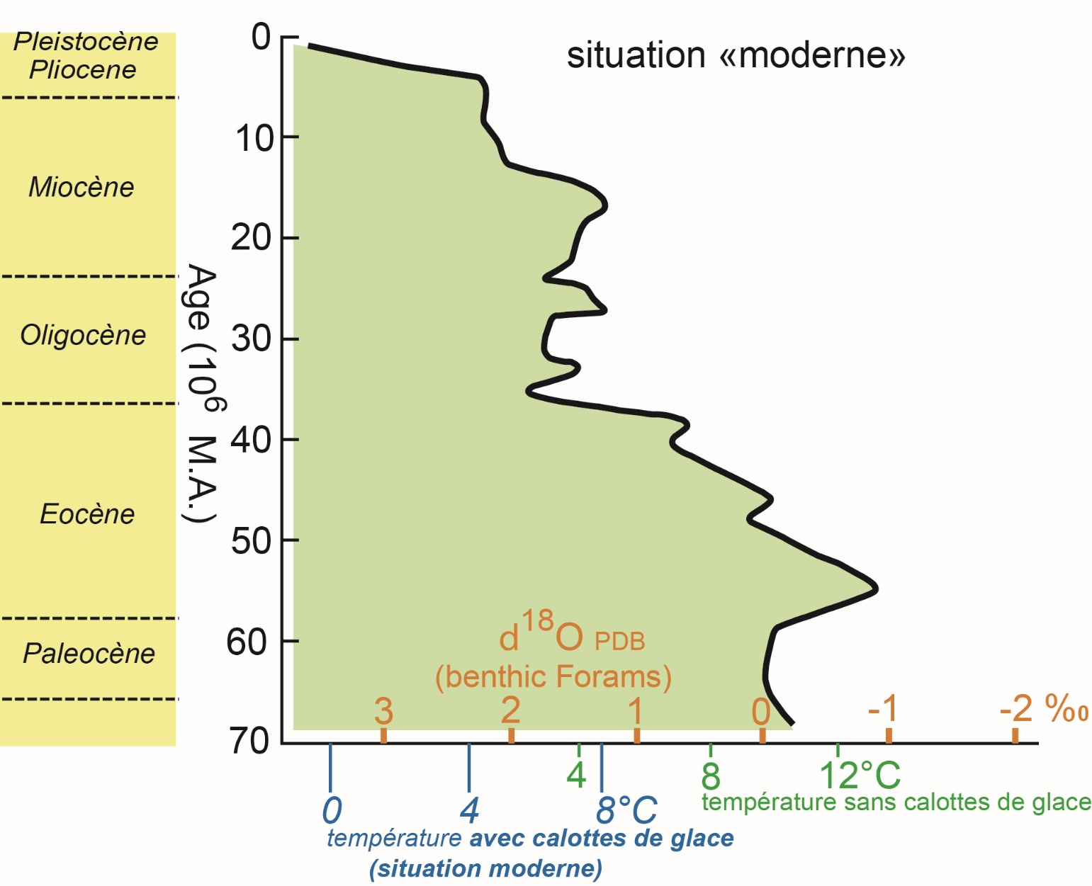
1 m
Env. 100 000 ans
Durée de la formation (datée avec précision)
Env. 100 000 years for major subdivisions
thus first order cycles = around. 20 000 years
Here: recording of excentricity et and precession

Slide 10
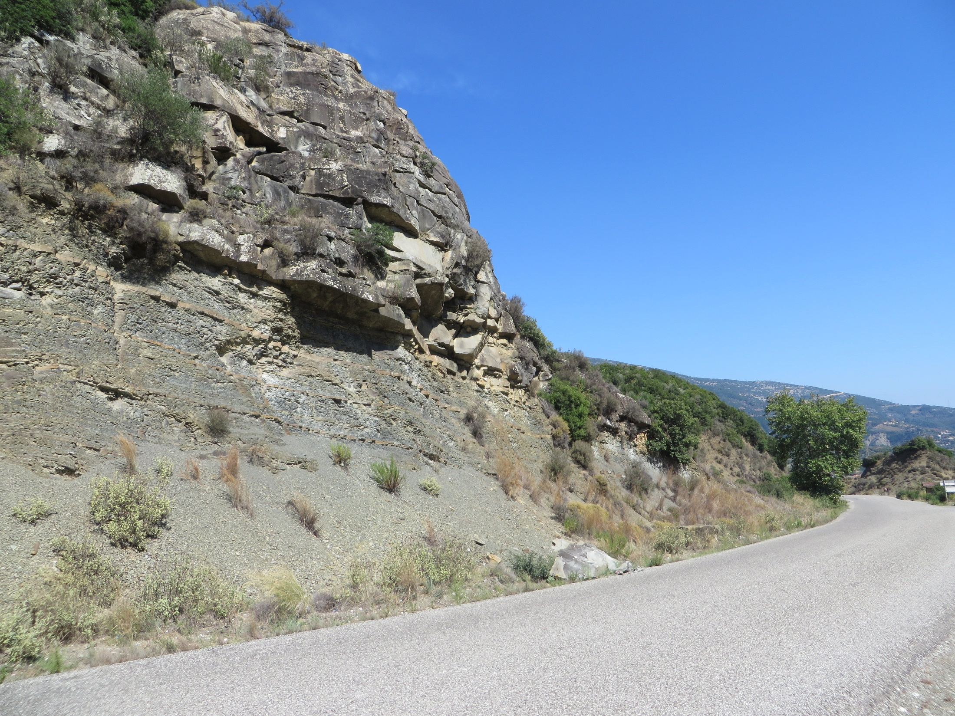
3

Slide 11
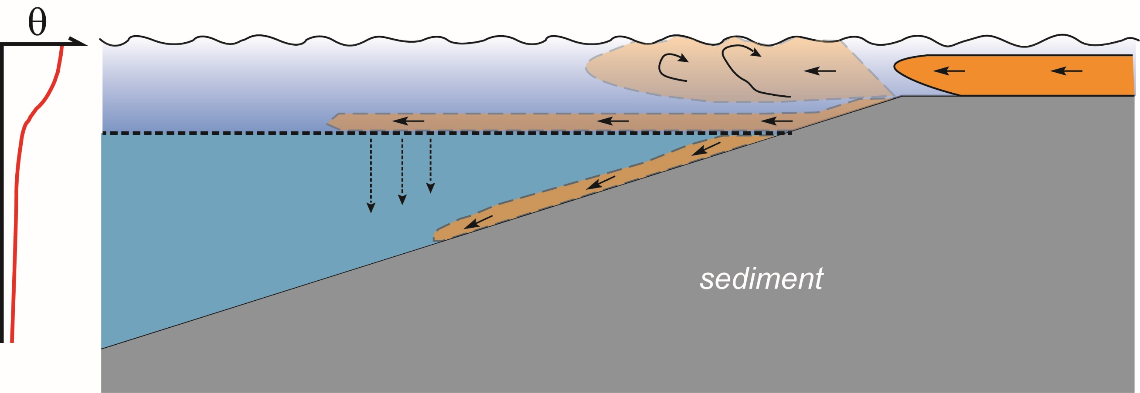
2
thermocline
3
1
4
1
terrigenous input (delta, tributaries, etc.)
2
overflow, mixing
3
interflow (or mesopycnal flow)
4
underflow (or hyperpycnal flow)

Slide 12
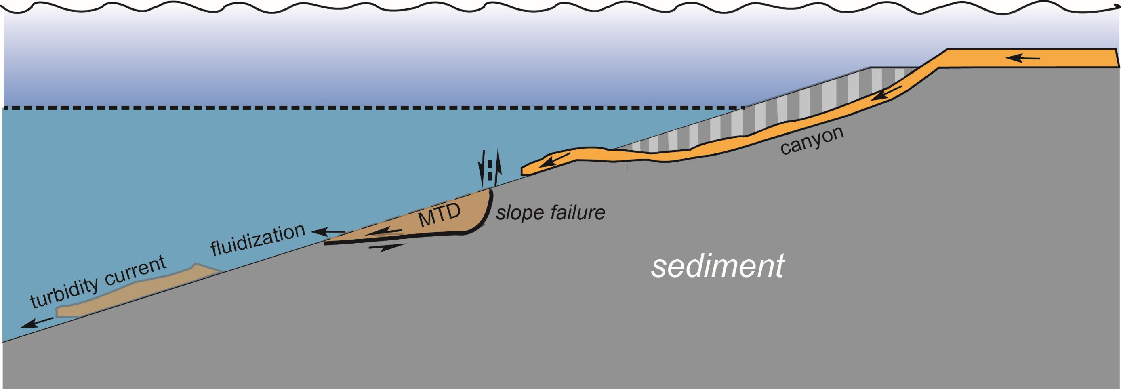
1
2
1
upslope-generated turbidity current, following canyon
2
deeper-seated slump (Mass Transport Deposit) evolving into a turbidity current

Slide 13
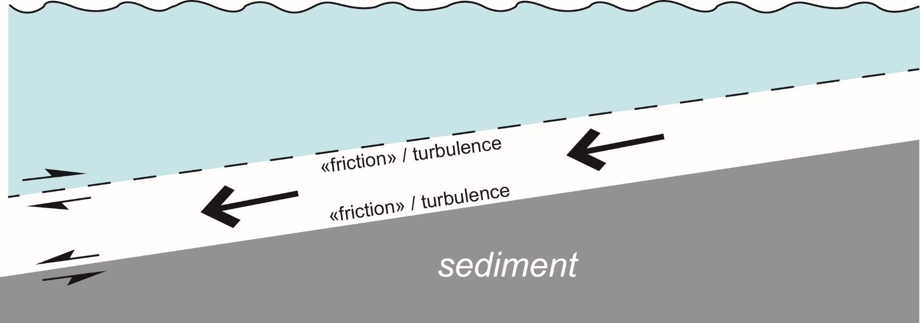
(separate) bottom current
because:
just water with higher density: lower temperature, higher salinity
generally low velocity: few cm.s⁻¹, few tens of cm.s⁻¹
fine-grained suspension: silty, clayey-silty, clayey (< ~100 μm)
turbidity current ( usually few 100 μm)
may reach high velocity: few m.s⁻¹
as it acts as a dense fluid, it is able to transport coarser particles
(sand and up to pebbles); if no coarse particles > fine-grained turbidite

Slide 14
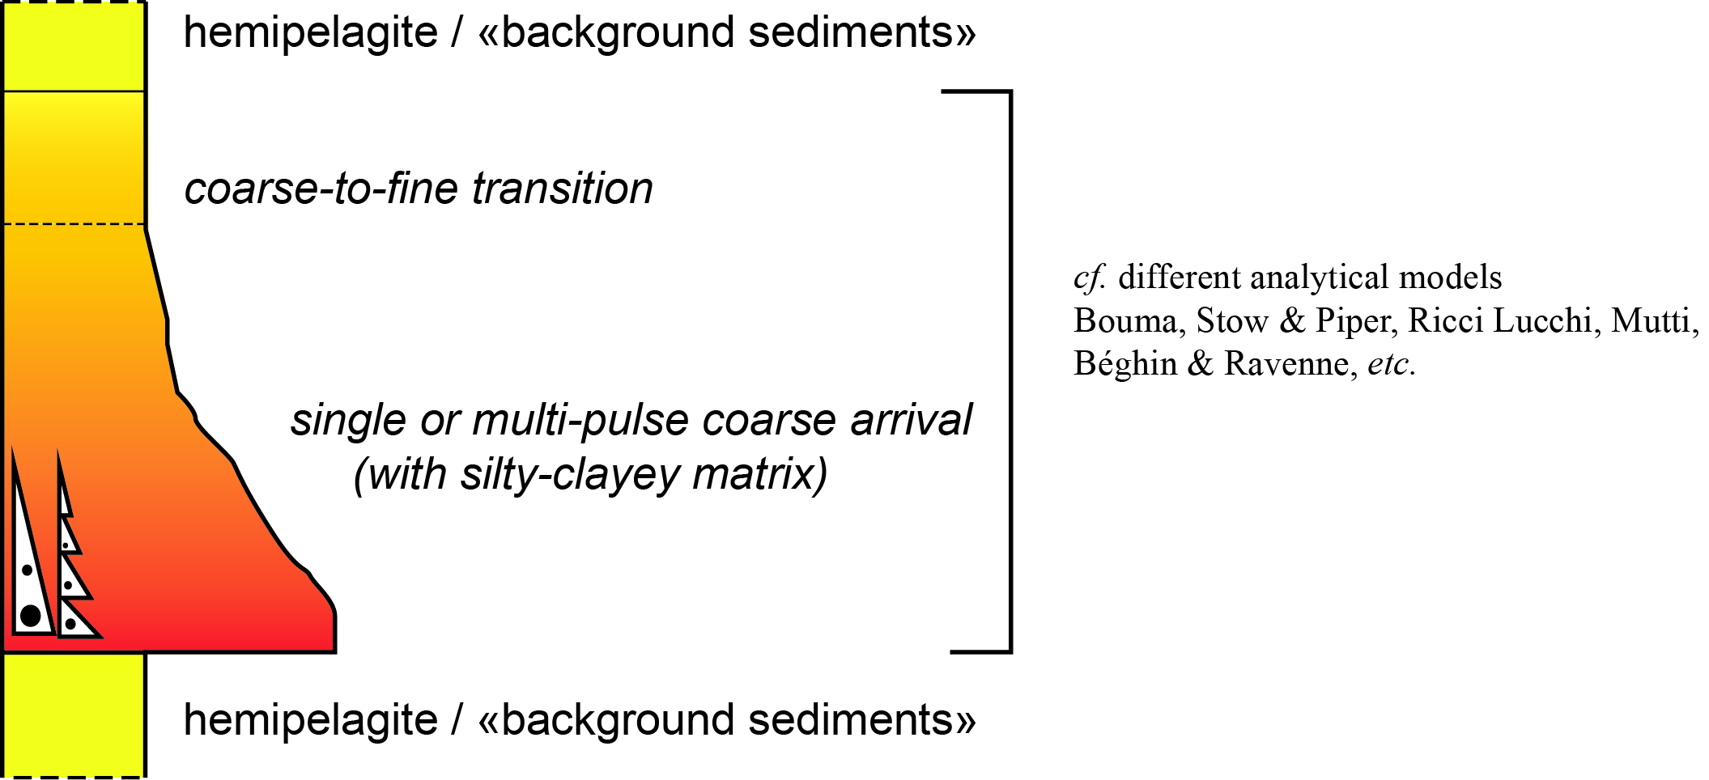
TURBIDITE (Tu)

Slide 15
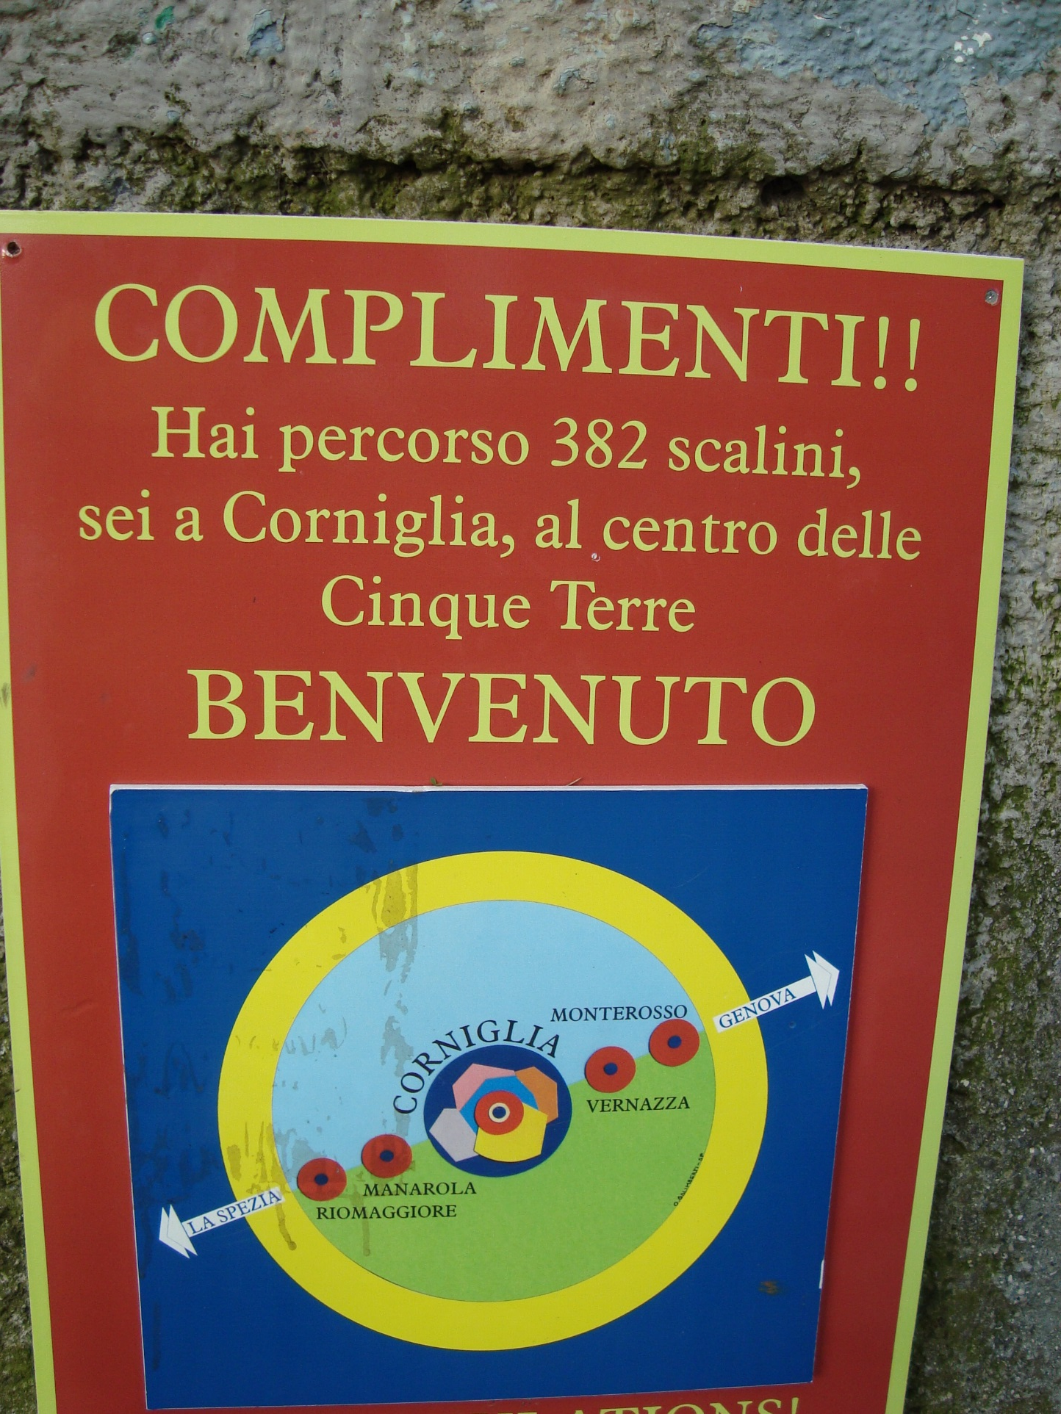
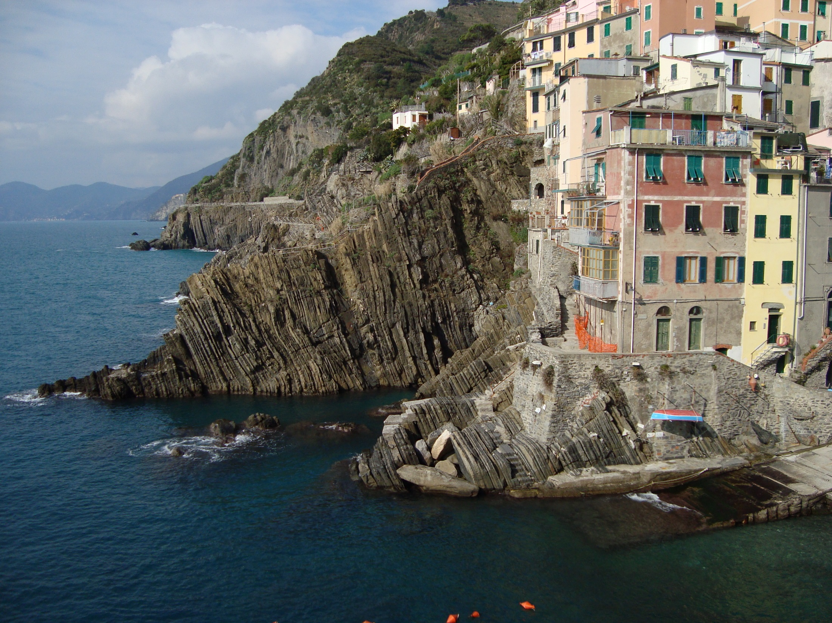
access to nice turbidites after some effort …

Slide 16
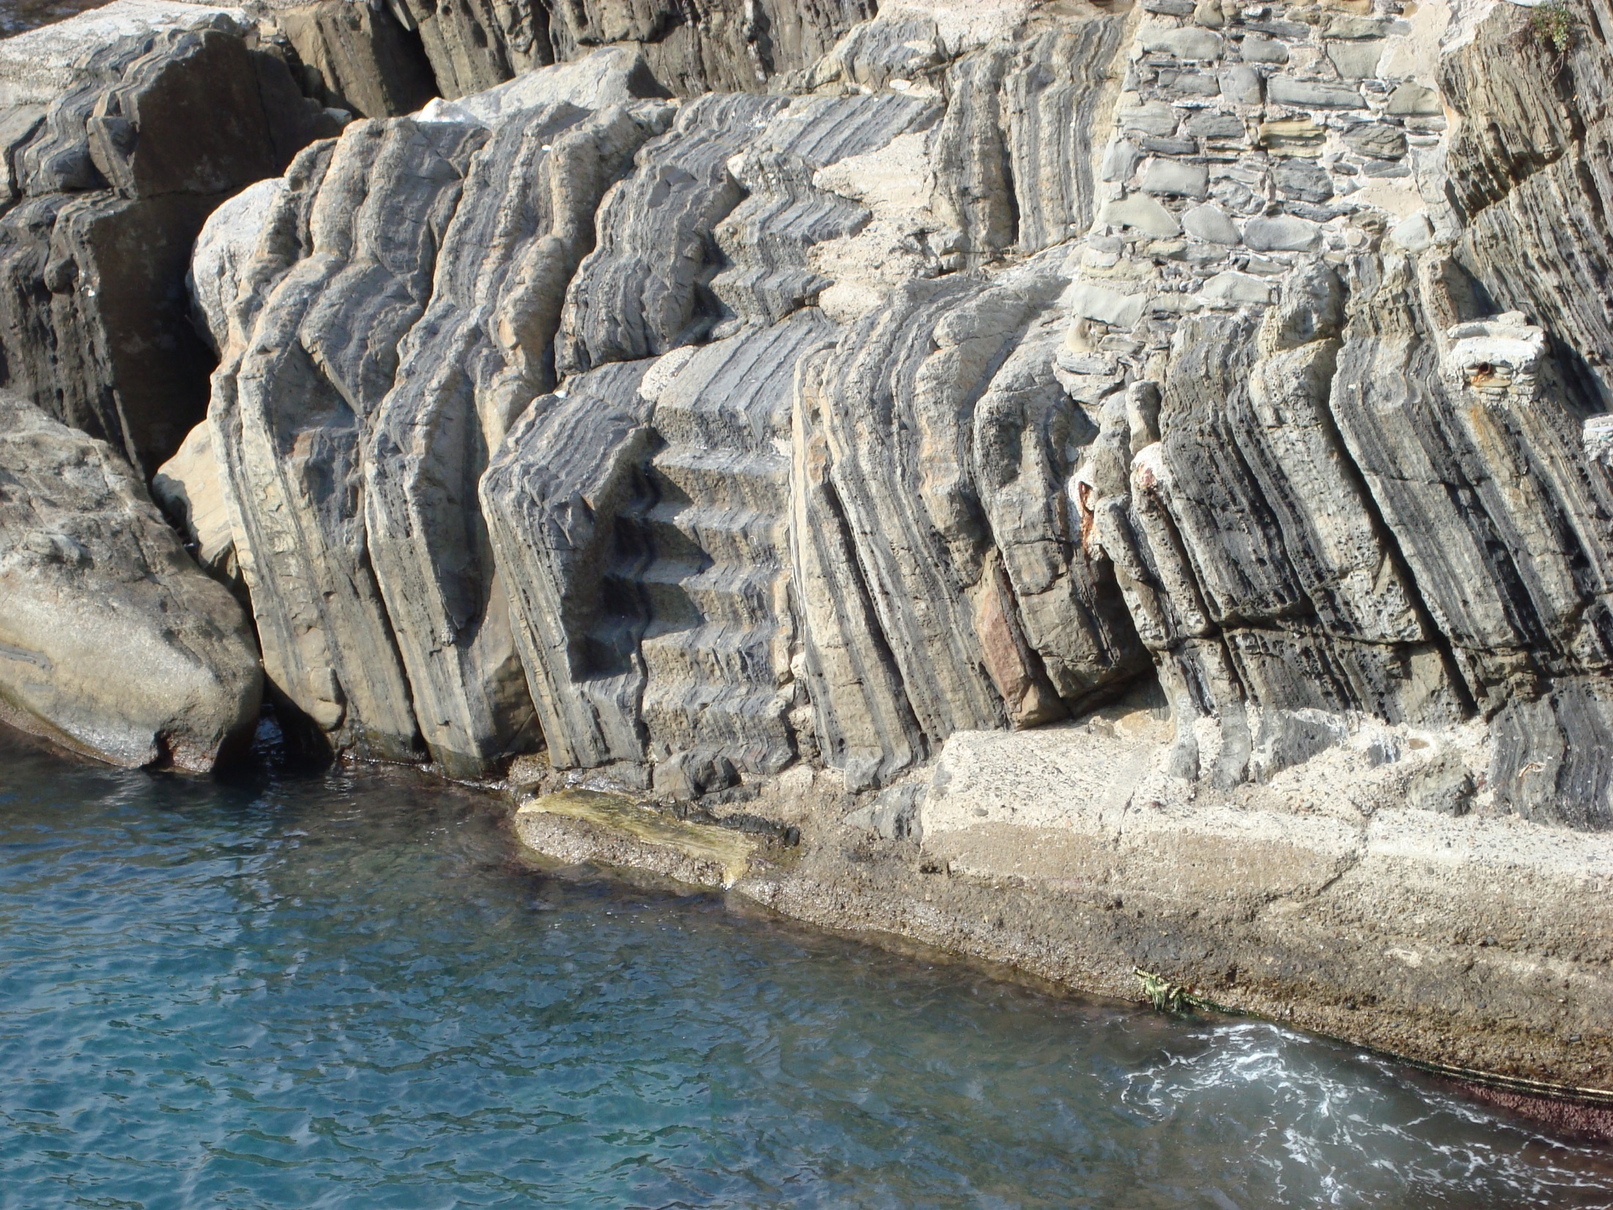
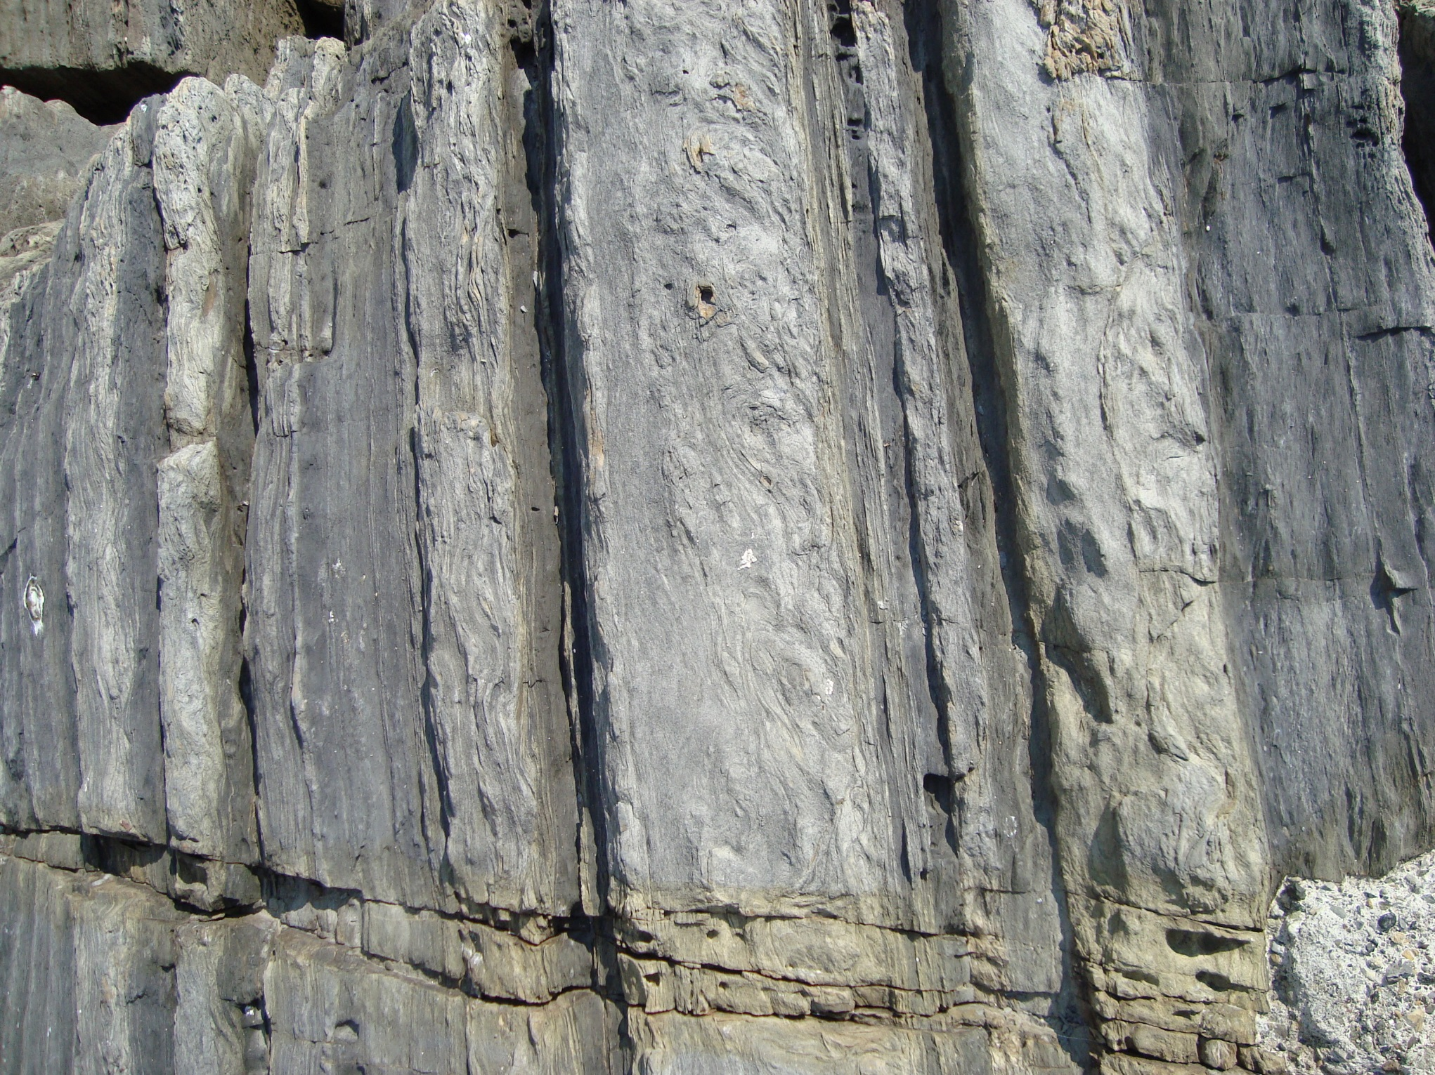

Slide 17
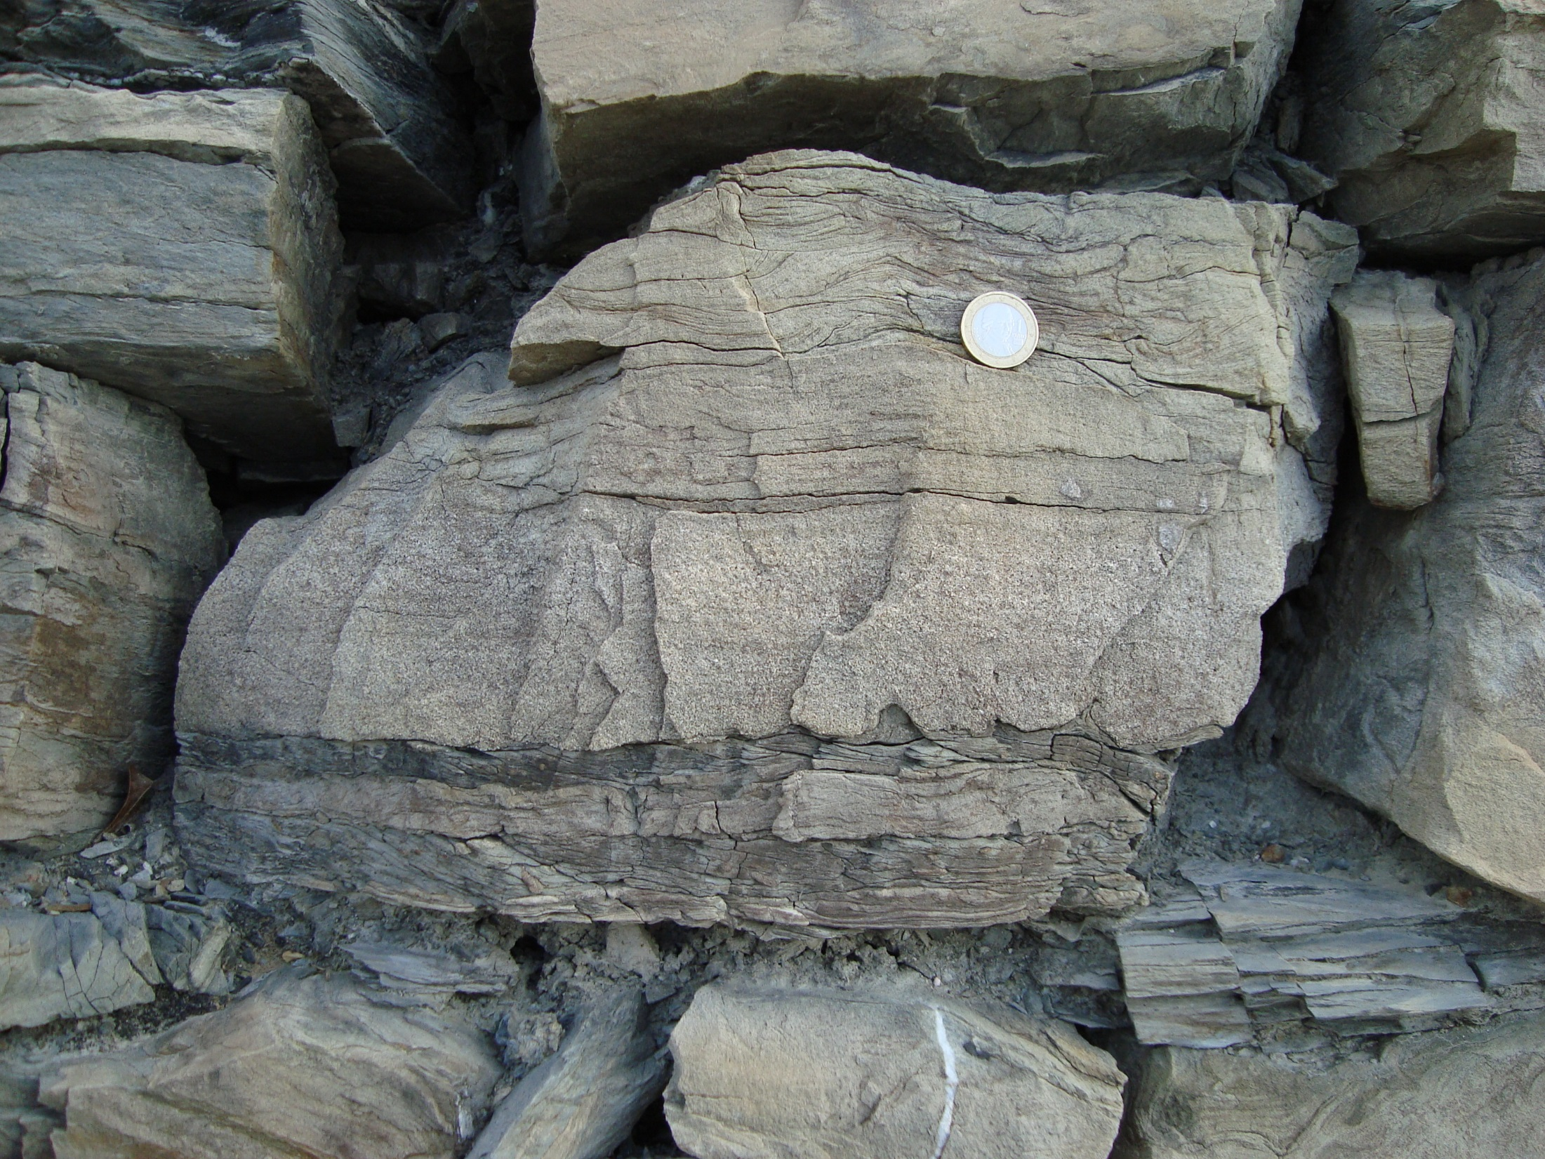
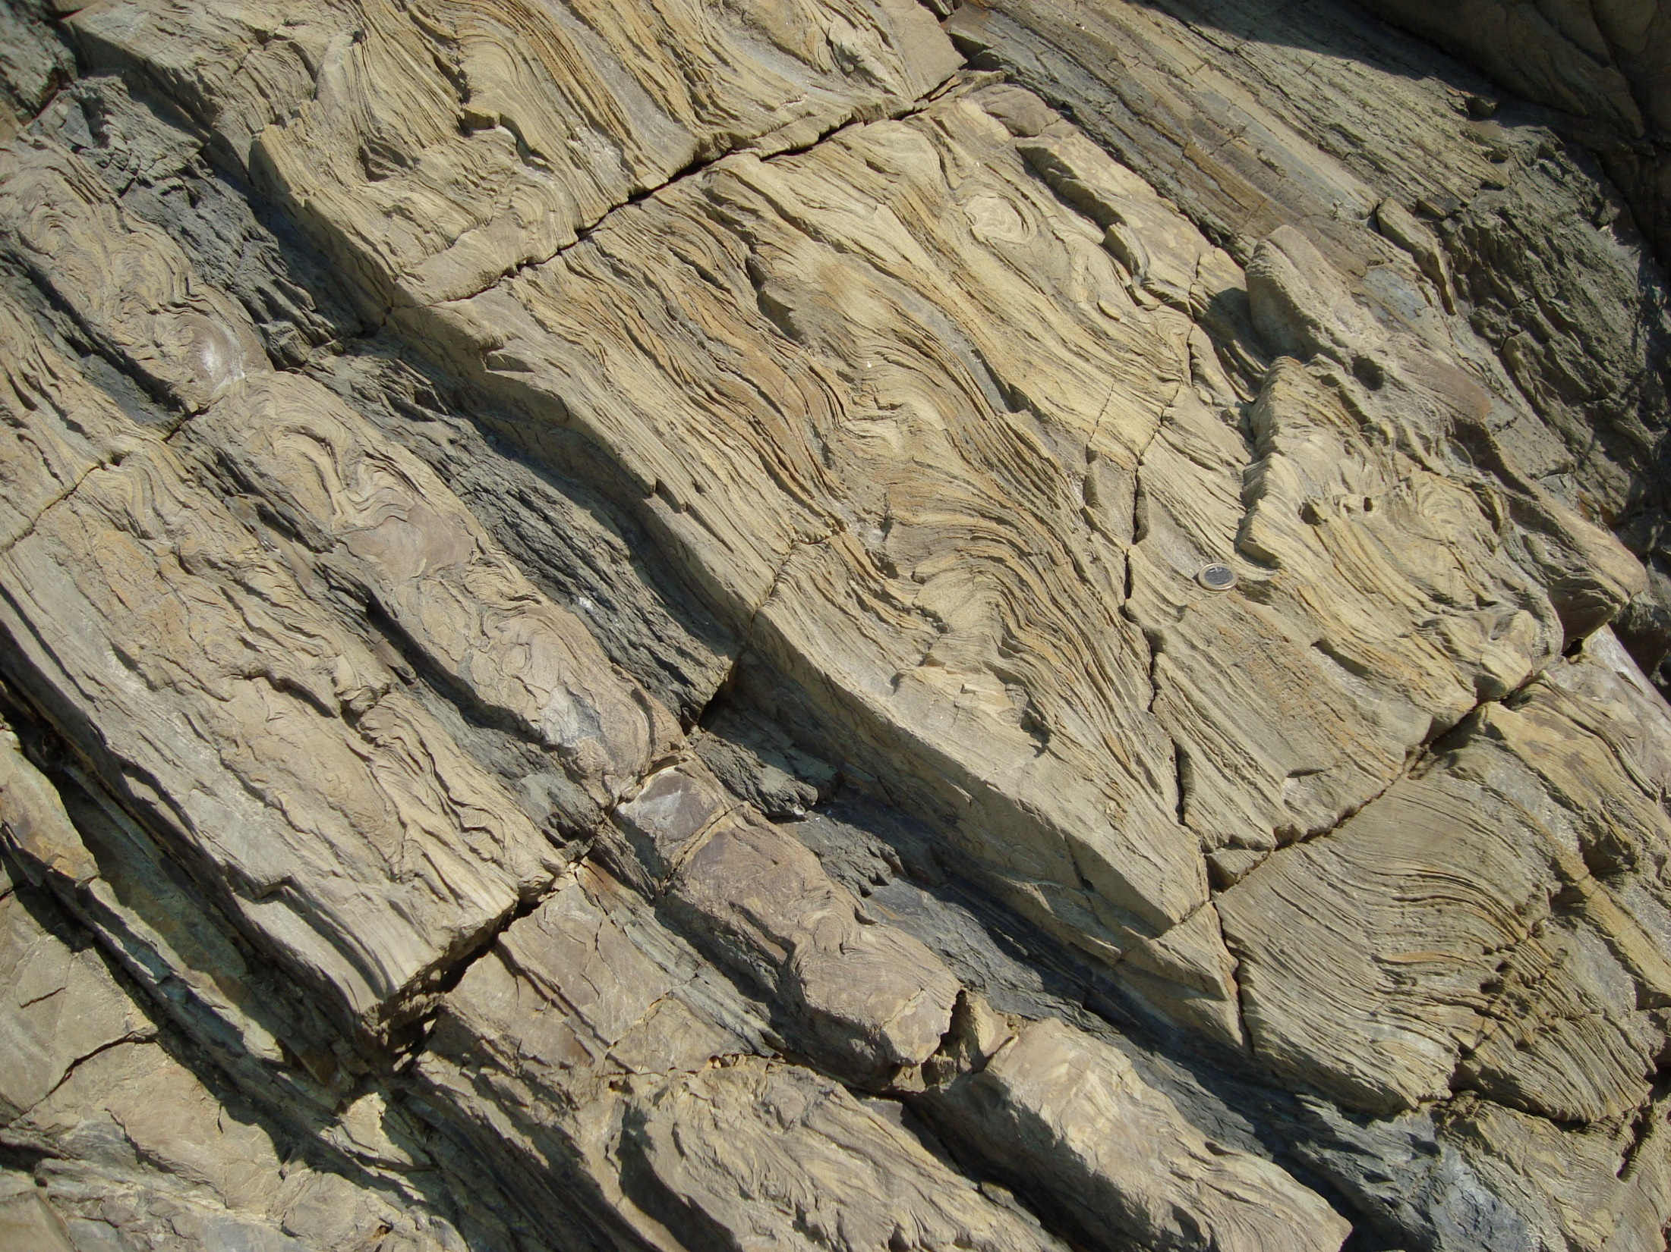

Slide 18
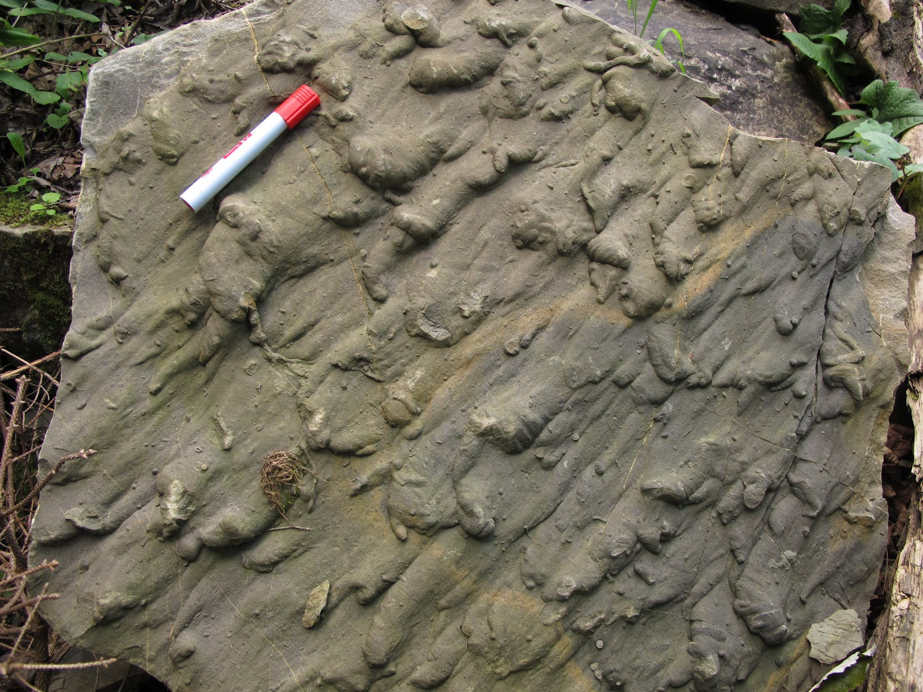
B
T
bottom surface viewed from below

Slide 19
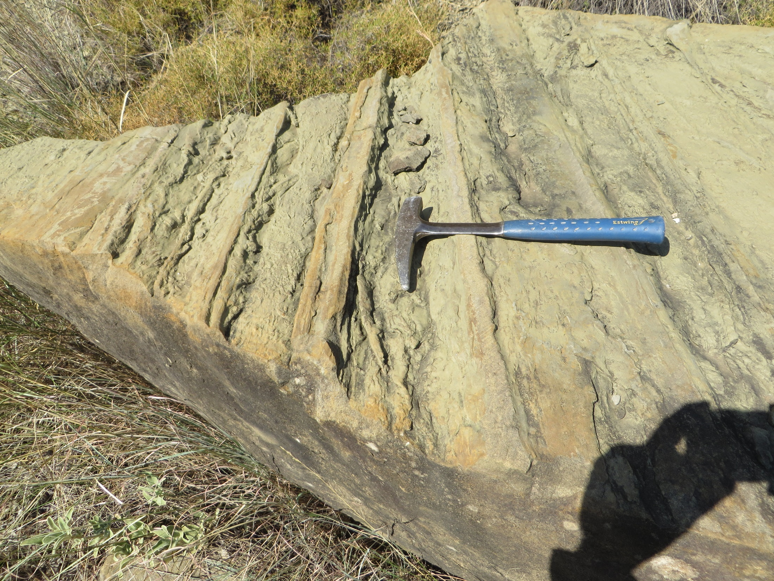

Slide 20
