Slide 1
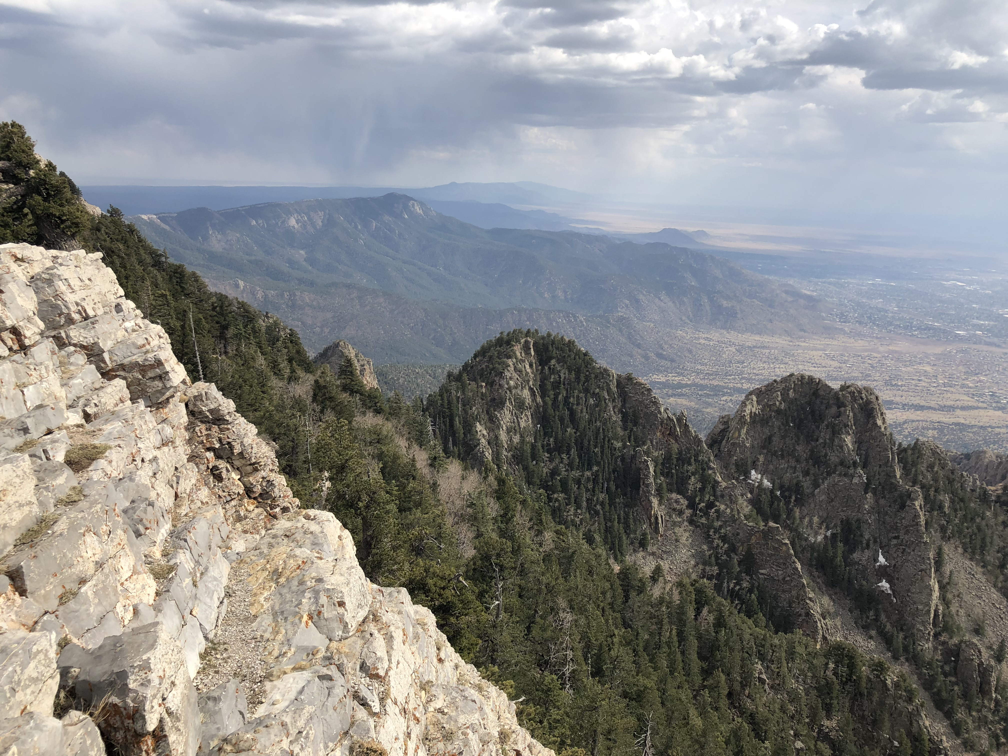
HOW TO BUILD A HALF-GRABEN
HOW TO BUILD A HALF-GRABEN
(an instruction manual)
JEAN-ARTHUR OLIVE
CNRS / Laboratoire de Géologie
de l’Ecole Normale Supérieure
olive@geologie.ens.fr

Slide 2




Co-authors & Acknowledgements
Luca Malatesta (UNIL)
Mark Behn (Boston College)
Roger Buck (LDEO / Columbia U.)
Paul Betka (LDEO / Columbia U.)
EAR-1650166
Actions Incitatives Grant 2018

Slide 3
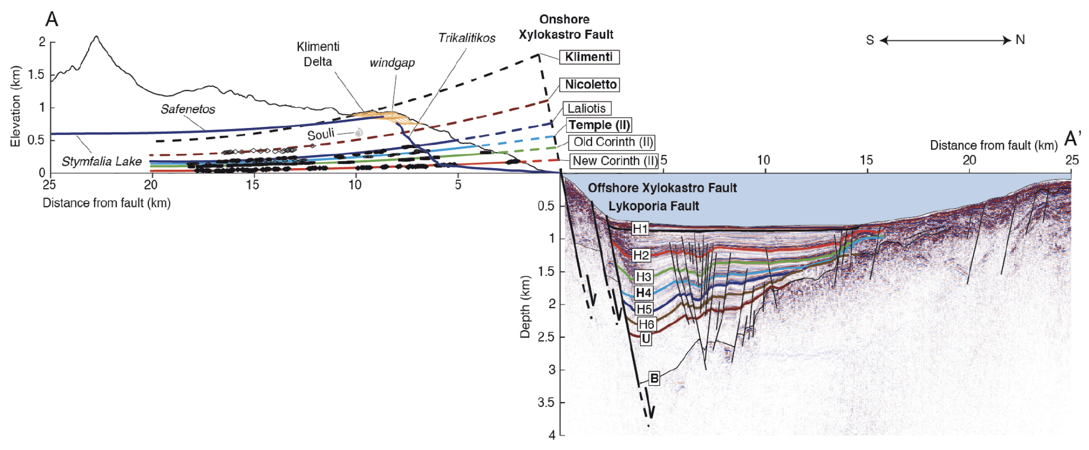
Half-graben structures
East African Rift, Western Branch
Eastern Gulf of Corinth (Greece)
master fault
hanging wall block
(The actual Gulf)
(north)
(south)
footwall block
(Peloponnese side)
Armijo et al. [1996]
de Gelder et al. [2018]
Taylor et al. [2011]

Slide 4
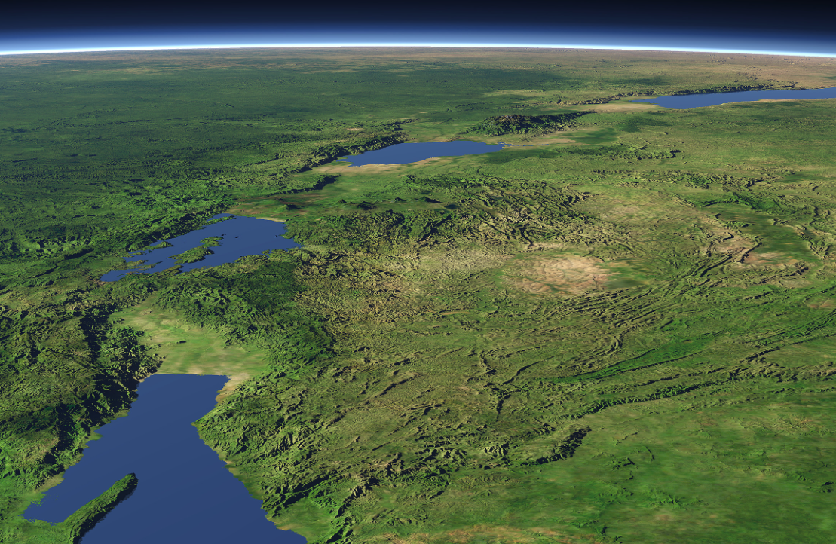
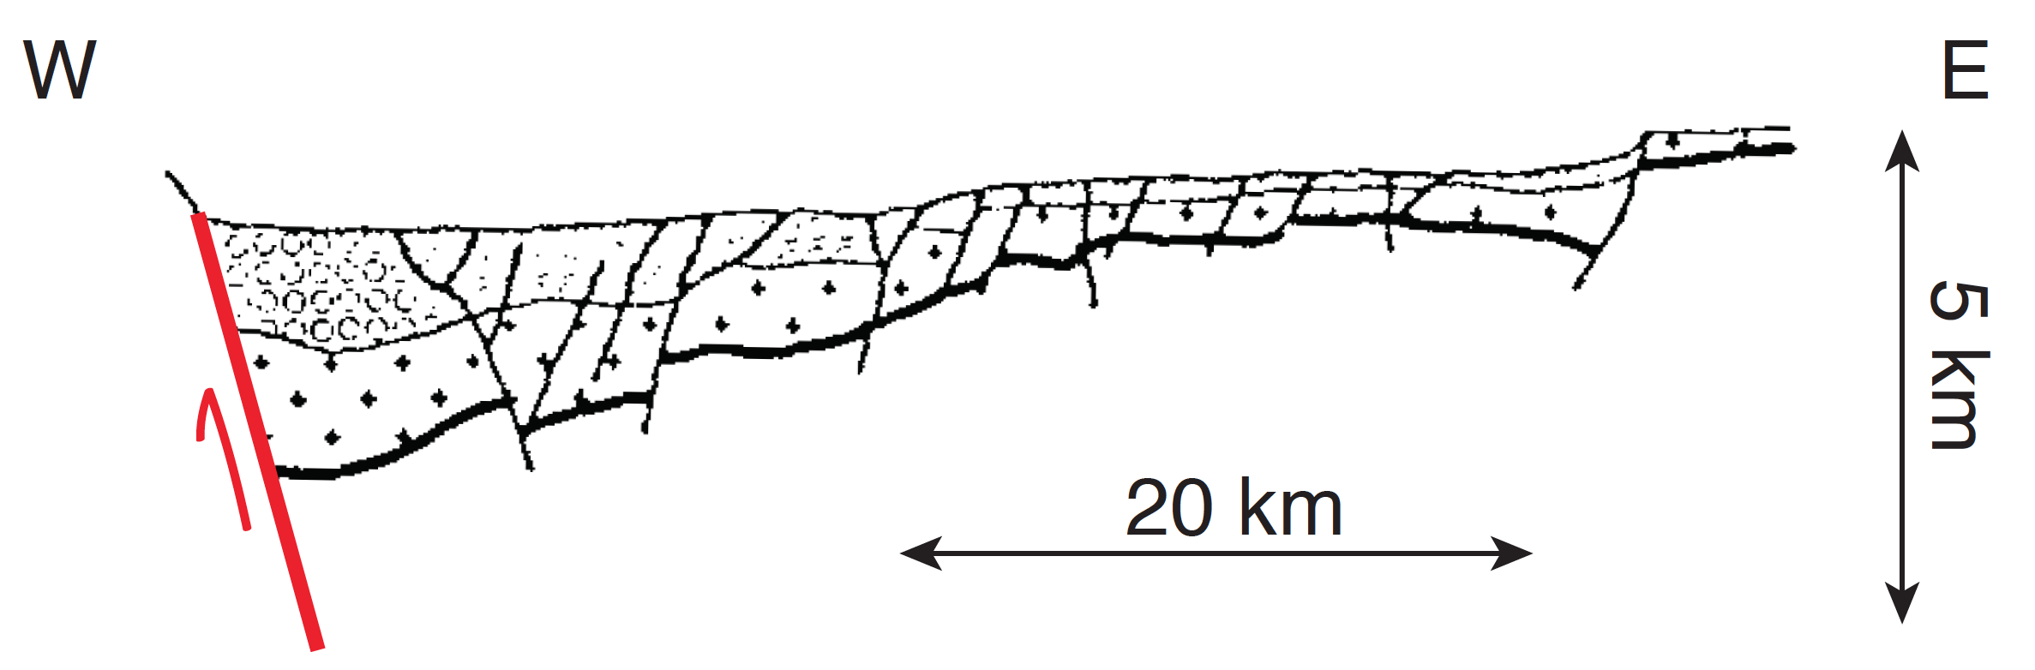
Half-grabens as building blocks for narrow rifts
East African Rift, Western Branch
Rwenzori
Mountains
N
Lake Albert
Lake Edward
Lake Kivu
20 km
Lake Tanganyika
Delvaux [1991]
C. Hormann

Slide 5
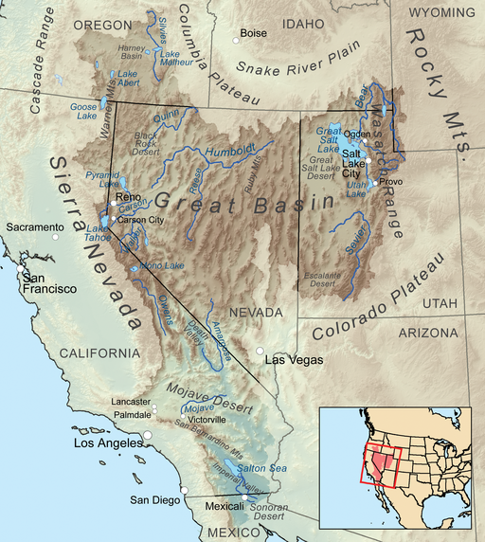
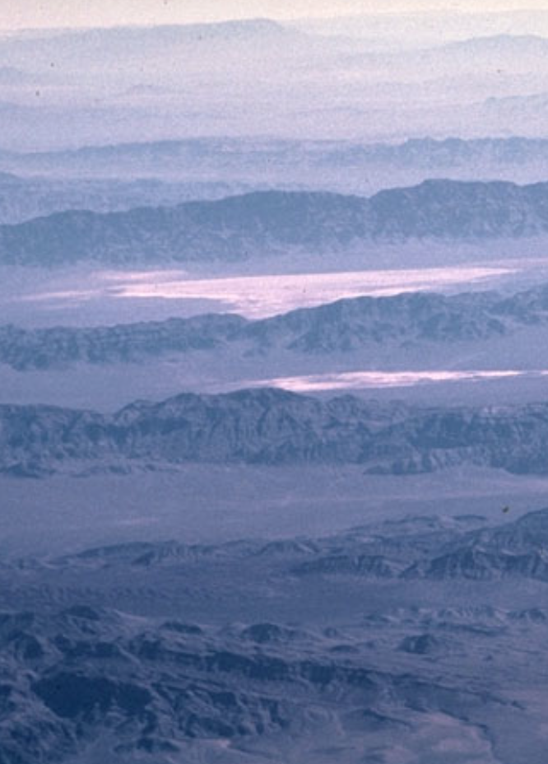
Half-grabens as building blocks for wide rifts
The Basin & Range
Province (Western US)
N
500 km
10–20 km
Wikipedia
USGS

Slide 6
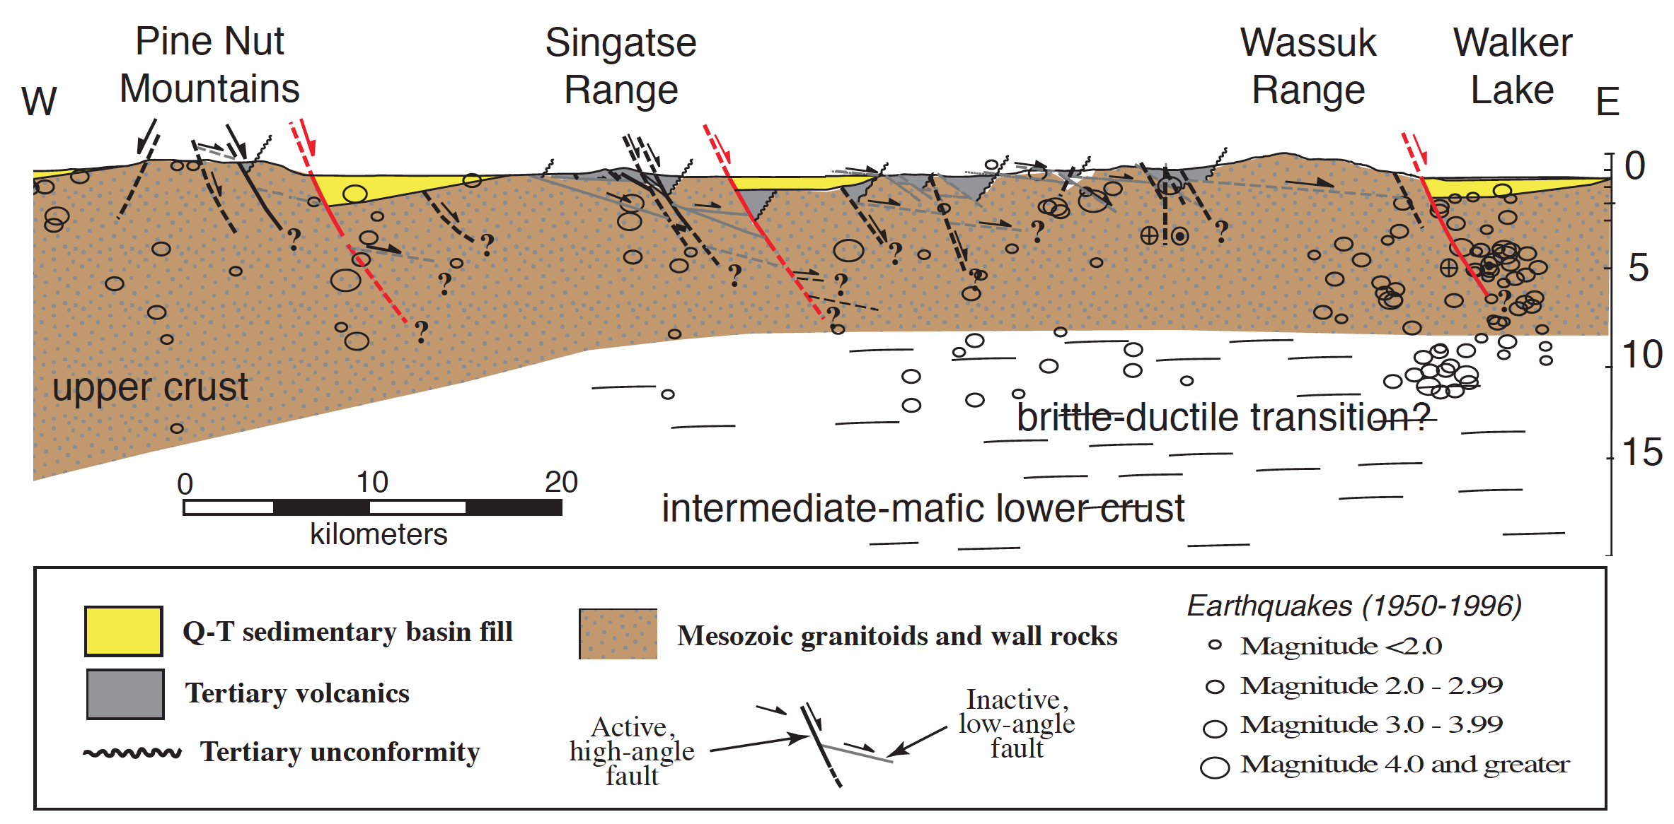
Half-grabens as building blocks for wide rifts
Surpless et al. [2002]

Slide 7
How to build a half-graben: Ingredients
LONG-LIVED
MASTER FAULT
(seismically active?)

Slide 8
How to build a half-graben: Ingredients
HANGING WALL
DOWN-WARPING
FOOTWALL
UP-WARPING
LONG-LIVED
MASTER FAULT
(seismically active?)

Slide 9
How to build a half-graben: Ingredients
SURFACE
PROCESSES
sedimentation
erosion
HANGING WALL
DOWN-WARPING
FOOTWALL
UP-WARPING
LONG-LIVED
MASTER FAULT
(seismically active?)

Slide 10
How to build a half-graben: Ingredients
SURFACE
PROCESSES
sedimentation
erosion
HANGING WALL
DOWN-WARPING
FOOTWALL
UP-WARPING
LONG-LIVED
MASTER FAULT
(seismically active?)

Slide 11
How to build a half-graben: Master fault
LONG-LIVED
MASTER FAULT
(seismically active?)

Slide 12
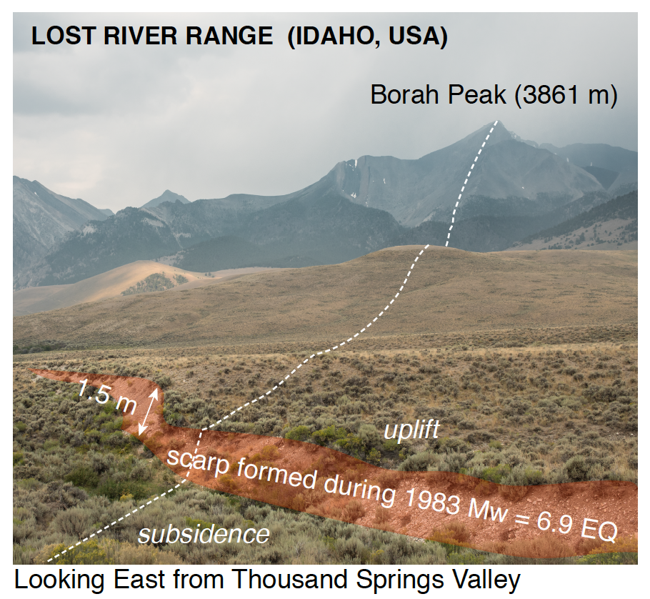
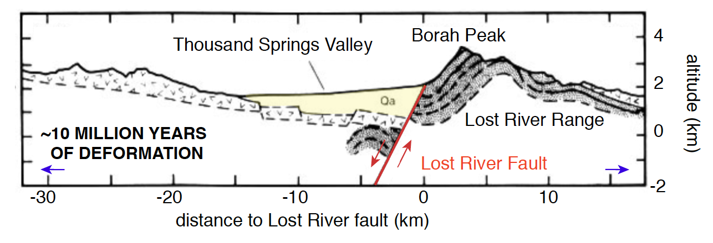
The master normal fault
Stein & Barrientos [1985]

Slide 13
The master normal fault

Slide 14
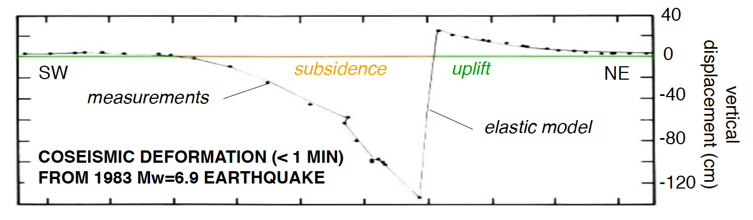
The master normal fault
Lost River fault: dip 45º, total offset ≈ 5 km, seismogenic depth ≈ 10-15 km
Stein & Barrientos [1985]

Slide 15
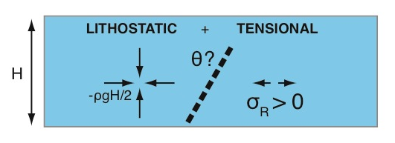
How hard is it to break a normal fault?
in an Andersonian stress state
with Byerlee friction (≈0.6):
Optimal fault dip = 60º
OPTIMAL
FORBIDDEN

Slide 16
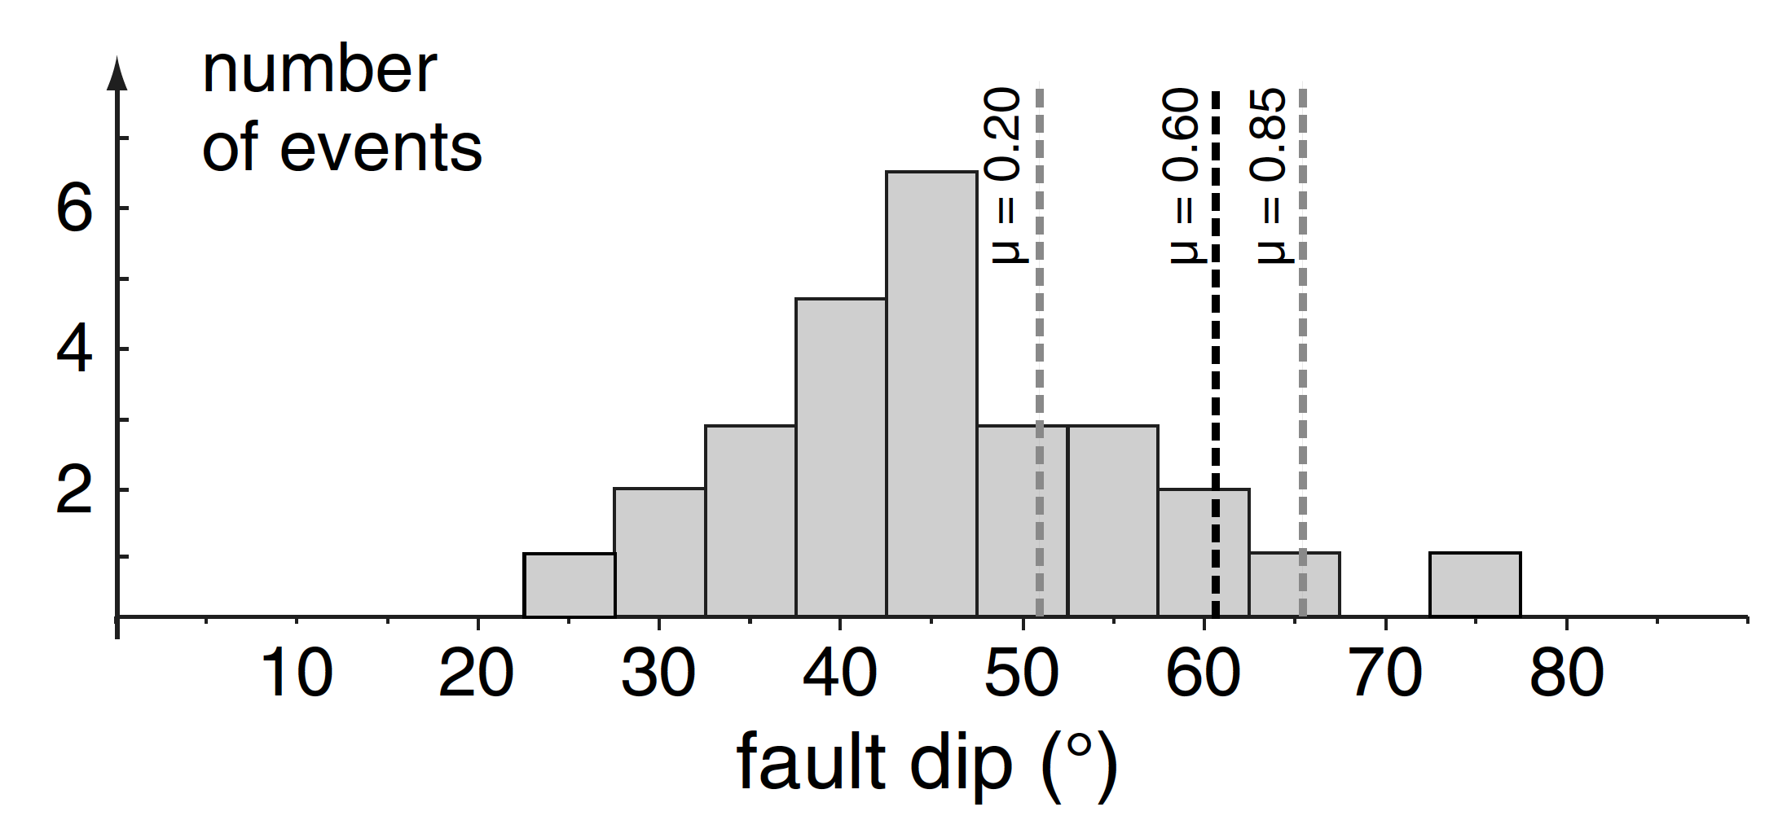
How hard is it to break a normal fault?
in an Andersonian stress state
with Byerlee friction (≈0.6):
Optimal fault dip = 60º
OPTIMAL
FORBIDDEN
W. Corinth
Alto Tiberina
Jackson & White [1989]
Olive & Behn [2014]
LANFs

Slide 17
Rotating from 60º to shallower angles
Domino-style rotation:
Flexural rotation:
INCREASING EXTENSION
Lavier et al. [1999]

Slide 18
How to build a half-graben: Flexure
HANGING WALL
DOWN-WARPING
FOOTWALL
UP-WARPING
LONG-LIVED
MASTER FAULT
(seismically active?)

Slide 19
Footwall and hanging wall flexure
East African Rift, Western Branch
Eastern Gulf of Corinth (Greece)
master fault
hanging wall block
(north)
(south)
footwall block
Armijo et al. [1996]
de Gelder et al. [2018]
Taylor et al. [2011]

Slide 20
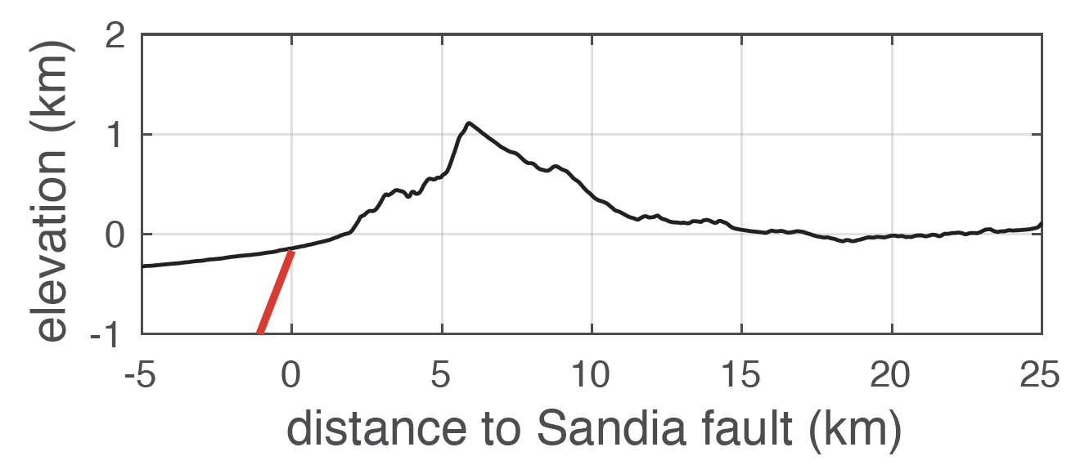
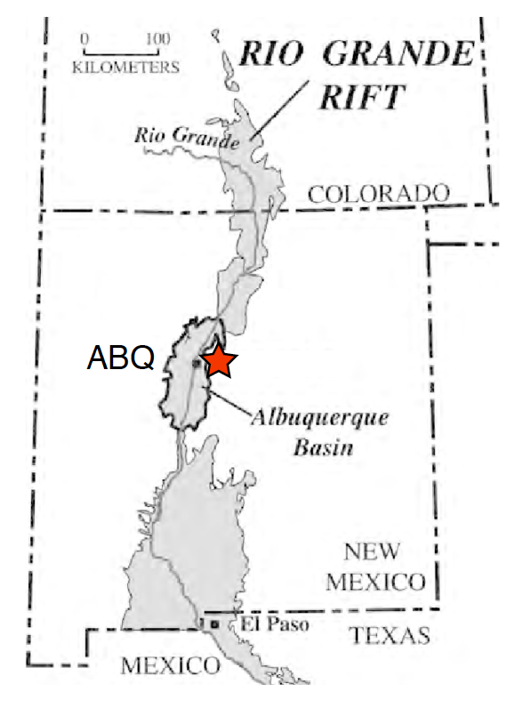
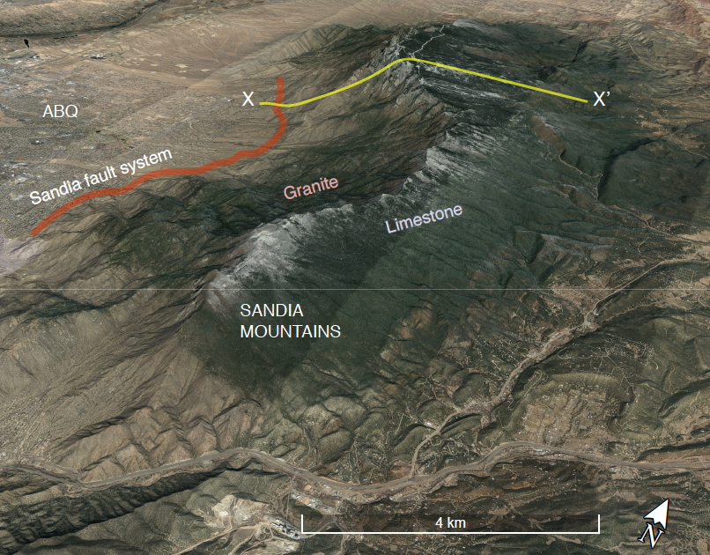
Footwall and hanging wall flexure
Sandia Mountains
(Rio Grande Rift,
New Mexico, USA):
X
X’

Slide 21
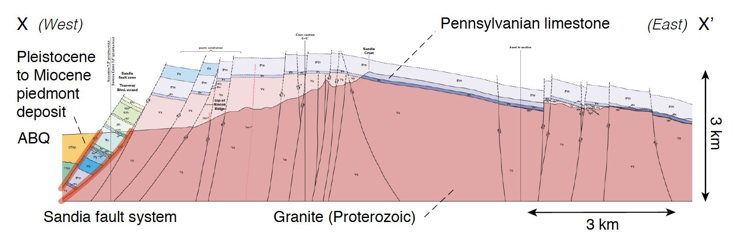
Footwall and hanging wall flexure
Sandia Mountains
(Rio Grande Rift,
New Mexico, USA):
X
X’

Slide 22
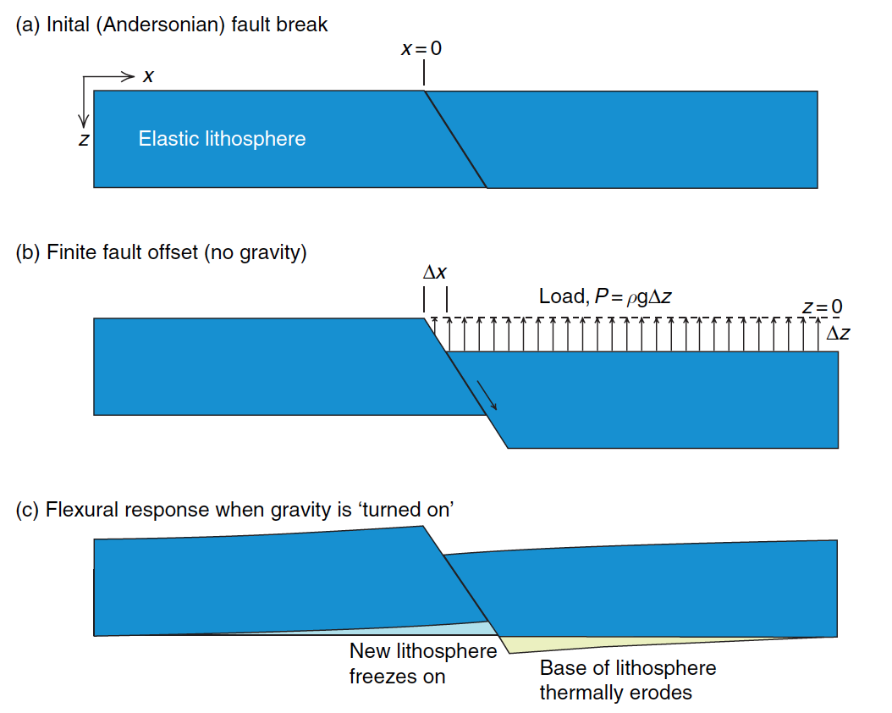
Modeling flexure of the upper crust
≈ 60º
thickness H
≈ 45º
Buck [2007]
Weissel and Karner [1989]

Slide 23
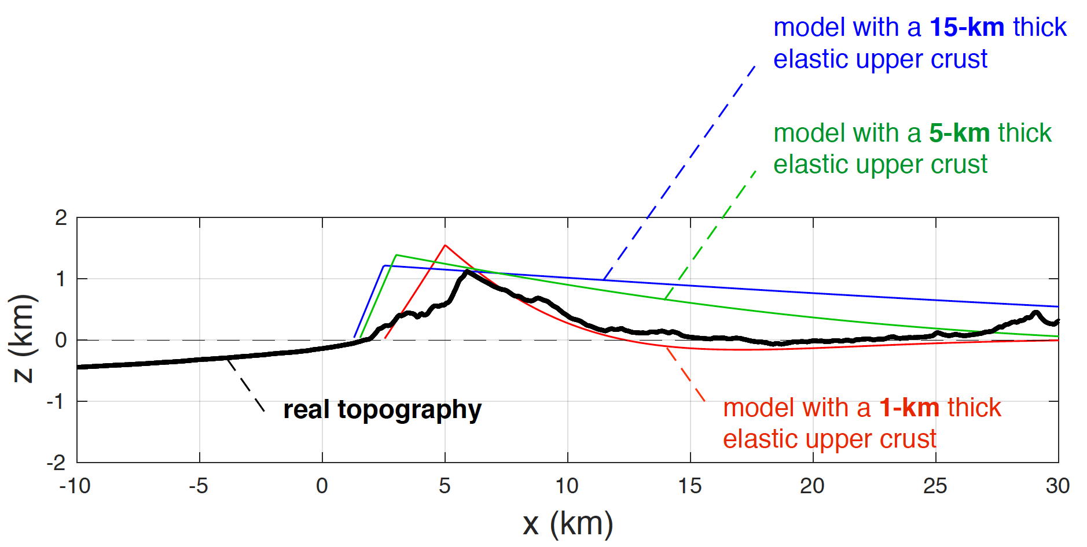
Modeling flexure of the upper crust
≈ 60º
≈ 45º

Slide 24
Modeling flexure of the upper crust
The 15-km thick upper crust
deforms like a 1-km thick elastic plate.
≈ 60º
The upper crust is NOT perfectly elastic !
≈ 45º

Slide 25
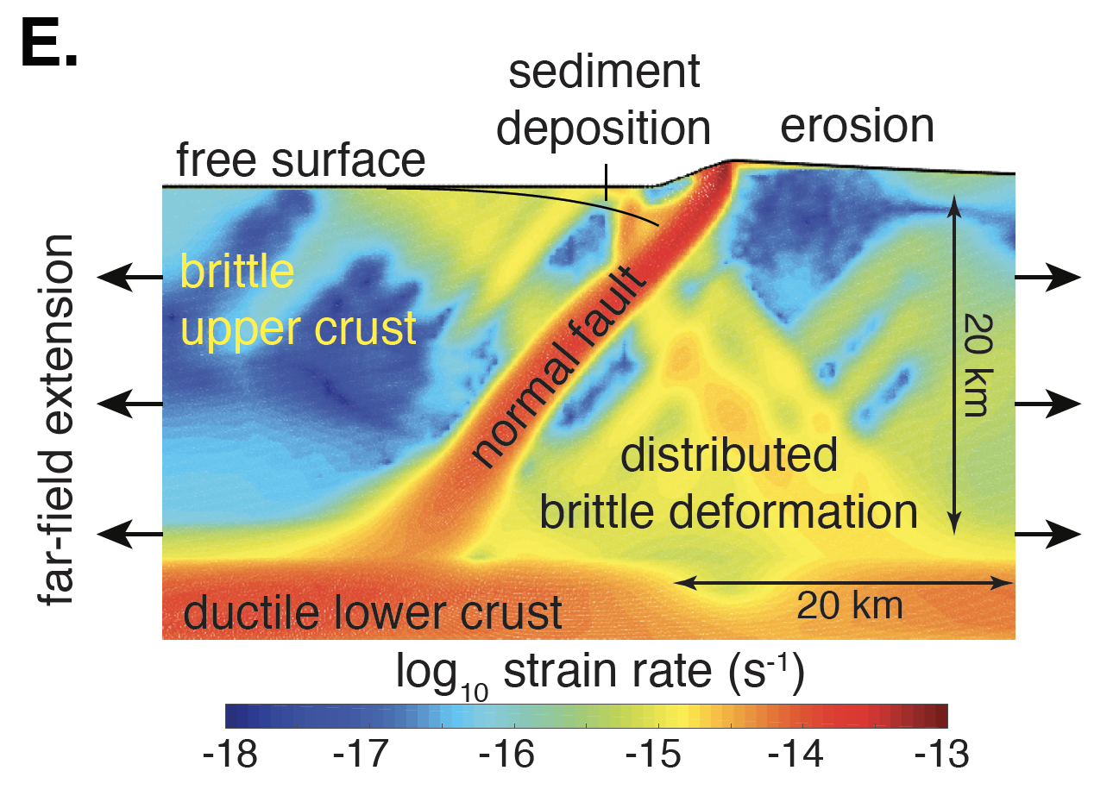
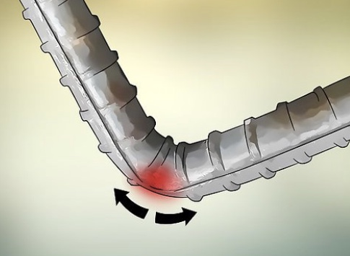
Modeling flexure of the upper crust
The 15-km thick upper crust
deforms like a 1-km thick elastic plate.
≈ 60º
The upper crust is NOT perfectly elastic !
Models must account
for visco-elasto-plasticity:

Slide 26
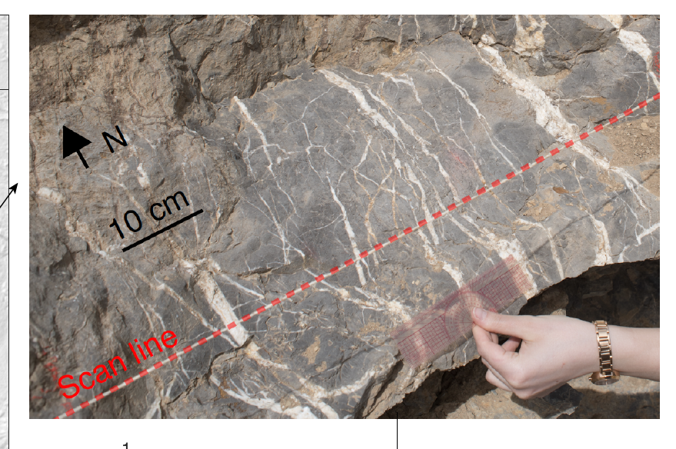
Damage in the warped footwall
Pervasive cracking on a range of scales: sub-mm to 10s of m
≈ 60º

Slide 27
How to build a half-graben: Surface processes
SURFACE
PROCESSES
sedimentation
erosion
HANGING WALL
DOWN-WARPING
FOOTWALL
UP-WARPING
LONG-LIVED
MASTER FAULT
(seismically active?)

Slide 28
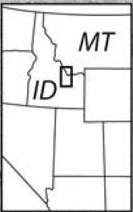
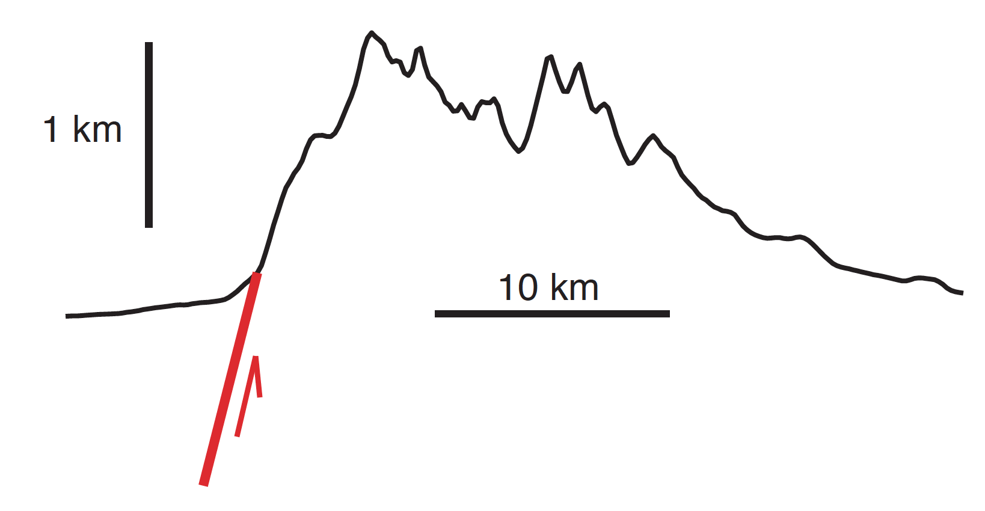
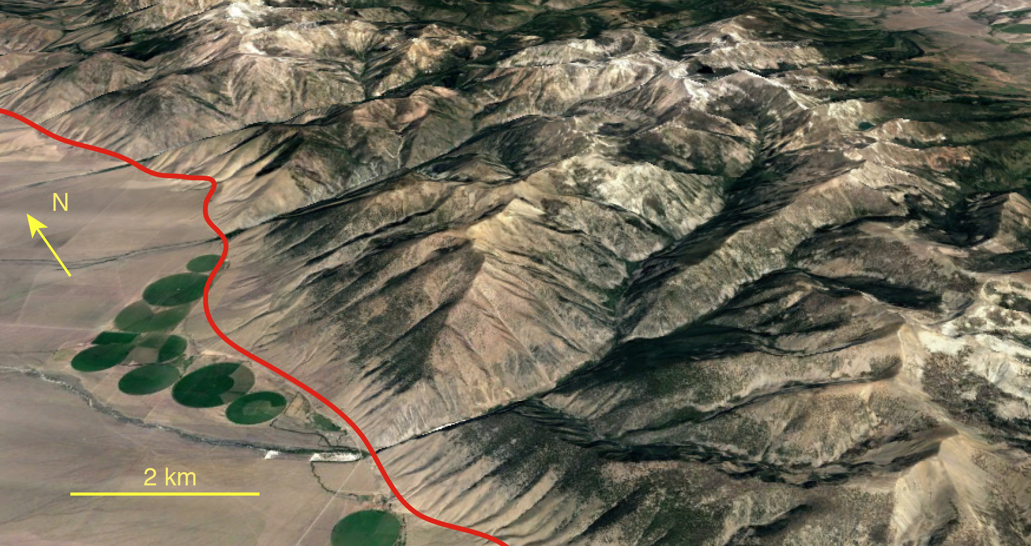
How is surficial mass redistributed ?
Lemhi Range, Idaho, USA
Topographic relief ≈ 1 km
Structural relief ≈ 4 km
[Anders et al., 1993]
Google Earth

Slide 29
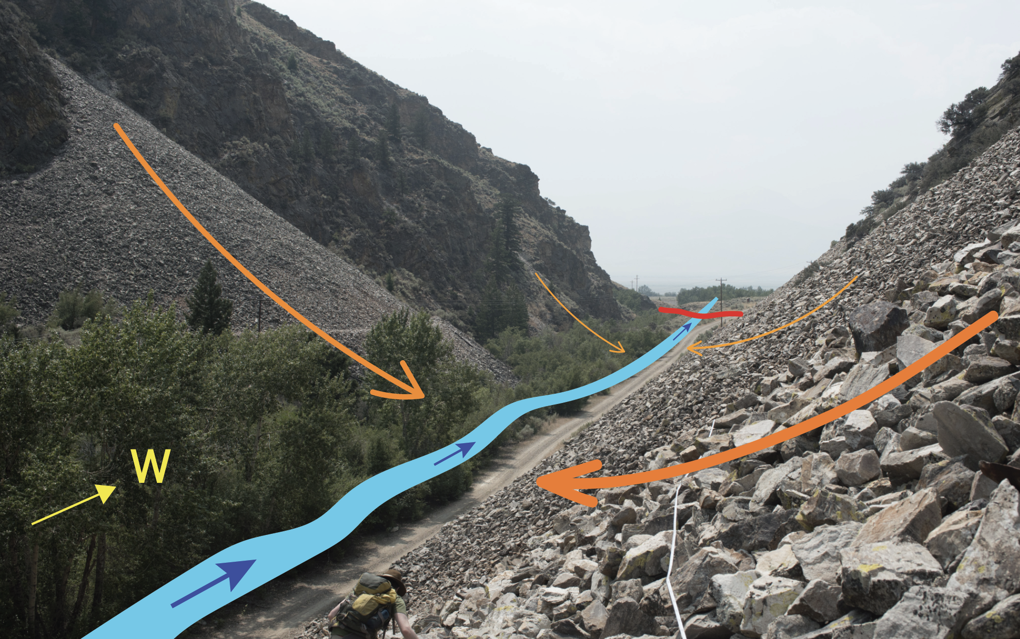
How is surficial mass redistributed ?

Slide 30
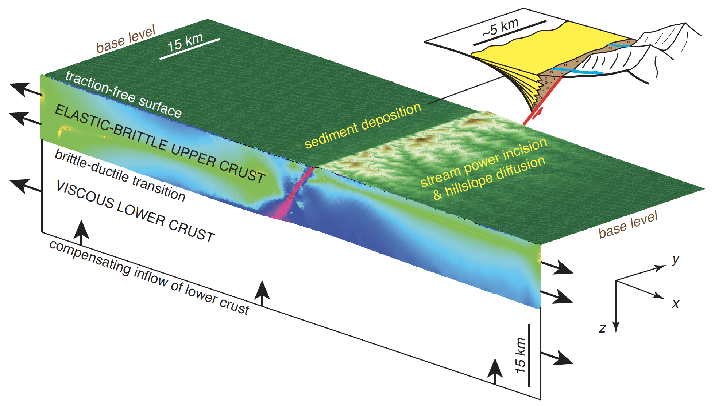
Coupled tectonic & surface evolution models

Slide 31
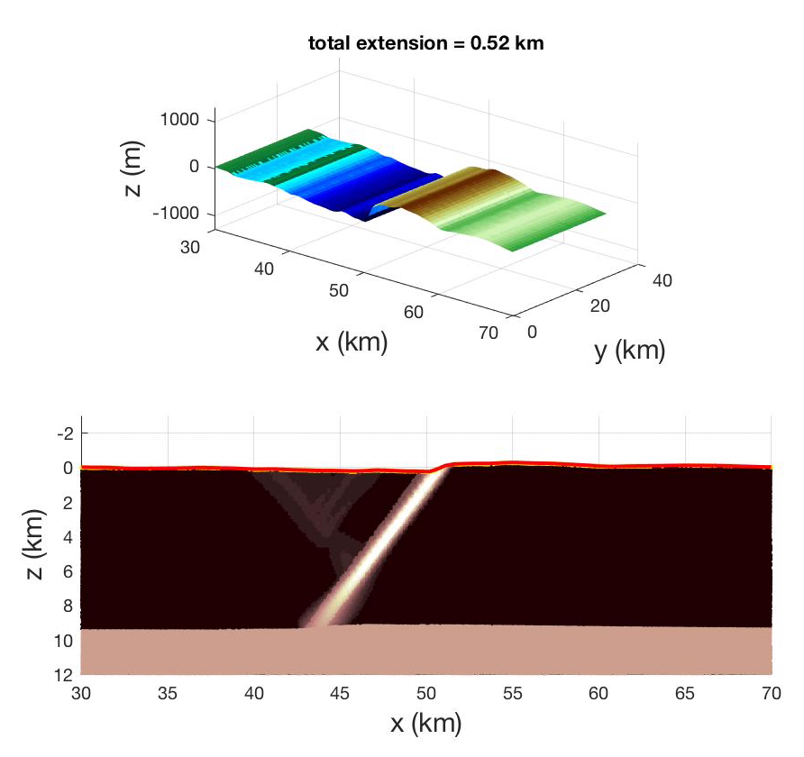
Half-graben growth subjected to surface processes
• Low erodibility
• No sedimentation
Half-graben
to graben after
3 km of extension.
Plastic strain:
BRITTLE
DUCTILE
Olive et al. [in prep]

Slide 32
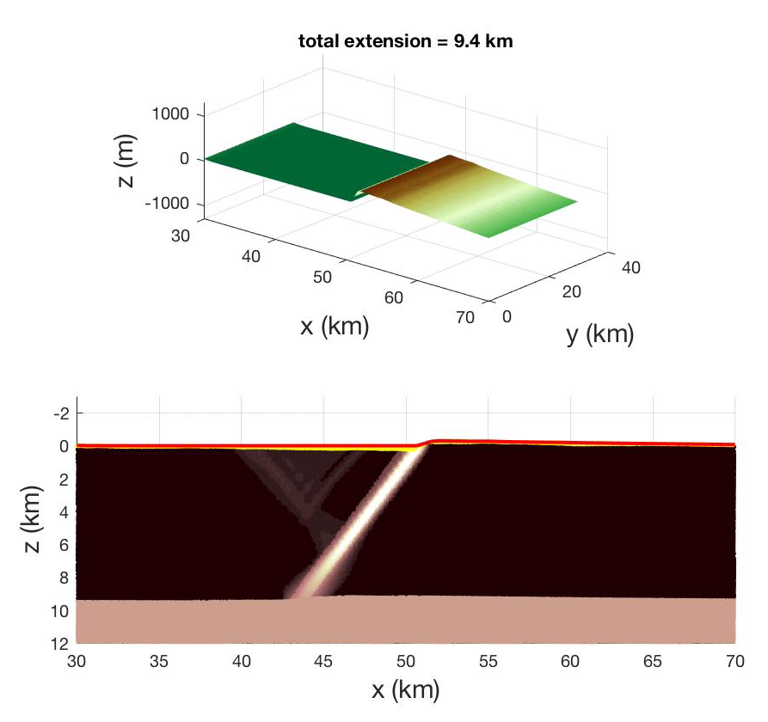
Half-graben growth subjected to surface processes
• Low erodibility
• Sedimentation
Half-graben
to graben after
4 km of extension.
Plastic strain:
BRITTLE
DUCTILE
Olive et al. [in prep]

Slide 33

Half-graben growth subjected to surface processes
• High erodibility
• Sedimentation
Stable half-graben.
Plastic strain:
BRITTLE
DUCTILE
Olive et al. [in prep]

Slide 34
How long can a half-graben stay active ?
SURFACE
PROCESSES
sedimentation
erosion
HANGING WALL
DOWN-WARPING
FOOTWALL
UP-WARPING
LONG-LIVED
MASTER FAULT
(seismically active?)

Slide 35
How long can a half-graben stay active ?
IS IT EASIER TO:
A/ Break a new master fault?
B/ Continue slipping
on the existing master fault?
Which requires less energy?

Slide 36
Energetics of normal faulting
How to keep a normal fault active ? [Forsyth, 1992]

Slide 37
Energetics of normal faulting
How to keep a normal fault active ? [Forsyth, 1992]
Supply extensional work

Slide 38
Energetics of normal faulting
How to keep a normal fault active ? [Forsyth, 1992]
Supply extensional work
Overcome frictional resistance on the fault

Slide 39
Energetics of normal faulting
How to keep a normal fault active ? [Forsyth, 1992]
Supply extensional work
Bend the faulted layer
Overcome frictional resistance on the fault

Slide 40
Energetics of normal faulting
How to keep a normal fault active ? [Forsyth, 1992]
Supply extensional work
Sustain the growth
of topography
Bend the faulted layer
Overcome frictional resistance on the fault

Slide 41
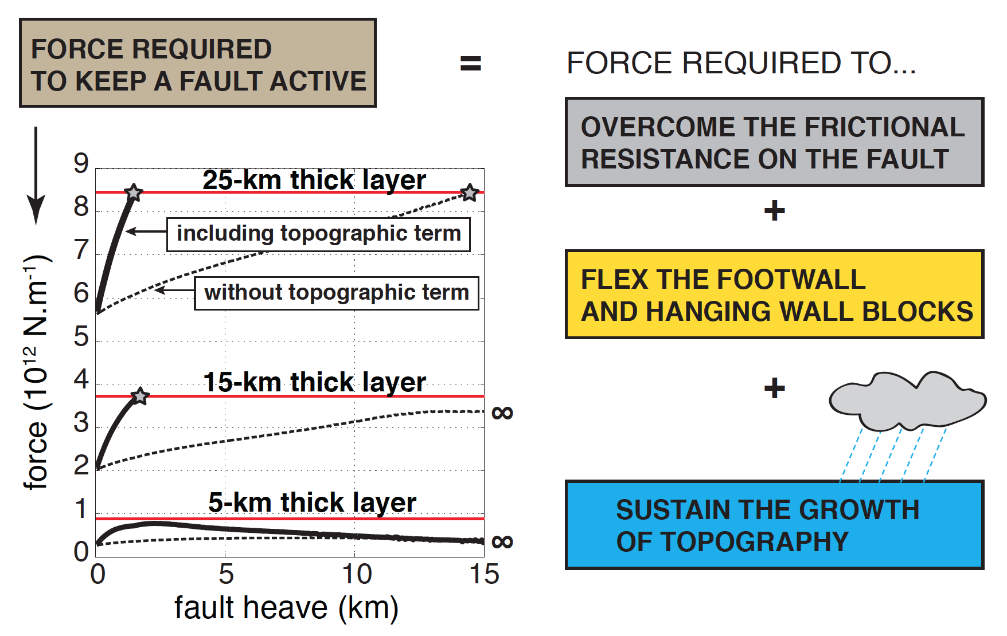
A simple force balance model for fault life span
[Olive et al. 2014]

Slide 42
A simple force balance model for fault life span
A new master fault forms after a few km of slip
on initial master fault.
ON / OFF
[Olive et al. 2014]

Slide 43
A simple force balance model for fault life span
Normal faults stay
active longer (forever?)
in thinner upper crust.
ON / OFF
[Olive et al. 2014]

Slide 44
A simple force balance model for fault life span
ON / OFF
[Olive et al. 2014]

Slide 45
How to build a half-graben: Conclusions
SURFACE
PROCESSES
sedimentation
erosion
HANGING WALL
DOWN-WARPING
FOOTWALL
UP-WARPING
LONG-LIVED
MASTER FAULT
(seismically active?)

Slide 46
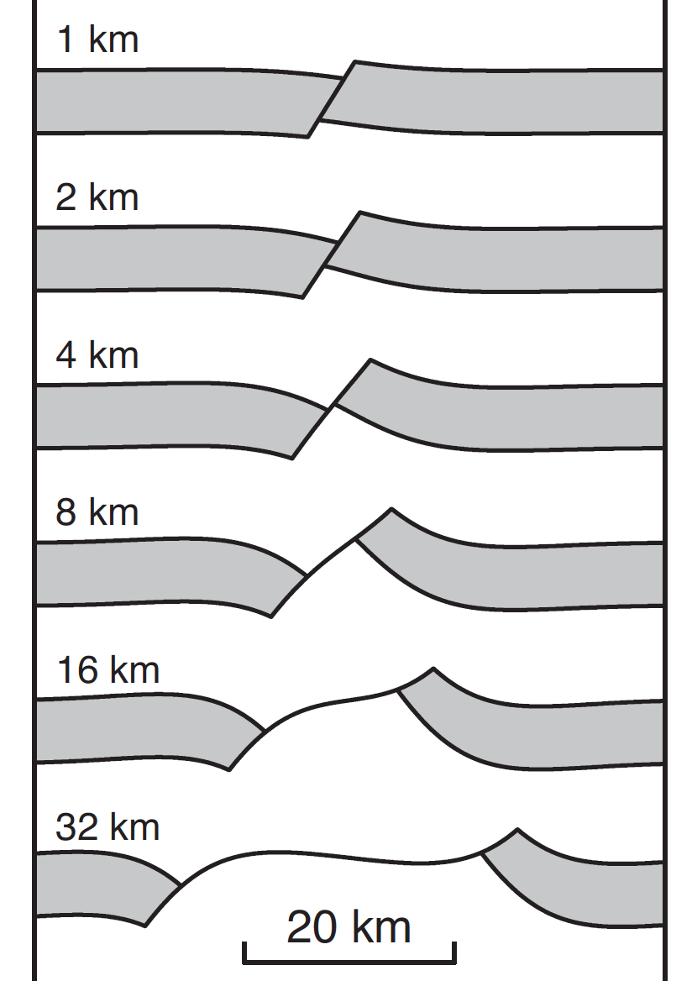
Conclusions
How to form a half-graben:
• Master normal fault breaks at 60º.
• Slip on master fault (seismic? aseismic?) induces flexure, rotation.
• Flexure rapidly becomes inelastic: damage & secondary faults.
• Damage may eventually coalesce to form new master fault
(if it doesn’t, we can end up with a core complex!).

Slide 47
Conclusions
How to form a half-graben:
• Master normal fault breaks at 60º.
• Slip on master fault (seismic? aseismic?) induces flexure, rotation.
• Flexure rapidly becomes inelastic: damage & secondary faults.
• Damage may eventually coalesce to form new master fault
(if it doesn’t, we can end up with a core complex!).
Half-grabens live longer with:
• thinner / weaker upper crust, weaker master fault.
• active surface processes eroding footwall / filling basin.
• weaker ductile lower crust.

